Slide 1
Peer-Reviewed Section Chapter Conferences and Opportunities for IEEE-USA Collaboration
Charles Rubenstein,
Chair, IEEE-USA Conferences Committee
c.rubenstein@ieee.org
2017 Region Meetings r1

Slide 2
Overview
Section Conference Objectives
Why should your section be involved with local conferences?
Types of Conferences
Financial vs. Technical Co-Sponsorships (FCS vs. TCS)
NEW MGA RULES: IEEE Technical Co-Sponsorships
Conference Budgeting
Income: Registration Fees, Patronage and Exhibit Fees , Seed Money Loans
Expenses: Catering and BEOs; WiFi Costs and other arrangements; Meeting Rooms
Sleeping Rooms vs. Meeting Rooms
Seed Money and Surpluses
Conference Mechanics
Typical Conference Committees
The Technical Program Committee
Call for Papers (CFP) and Peer Review Process (2 of 3 reviewers approve)
Preparing Papers for IEEE Xplore (Copyright transfer, Xplore CD)
Conference Technical Program: Track and Seesion Planning
IEEE-USA Conferences Committee and Services for Regions 1-6
Notes:
SDG

Slide 3
Section Chapter Conference OBJECTIVES
Section Chapter Conferences raise awareness of the section and its leadership within the local academic and industrial community.
The core objectives are:
Local Dissemination of IEEE’s Electrotechnology Topics
Creation of an alternate income stream for your section or chapter

Slide 4
Why should you be involved with local conference?
Networking with experts in your field
Serving on the TPC as a Reviewer you’ll see how peer-review works and how to improve your papers
The leadership, finance and catering techniques learned will give you the confidence to seek other conferences in your section
Volunteering is fun!

Slide 5
Types of Conferences
‘No papers’ Industry Conferences & Workshops
‘Talking Heads’ small academic conferences
Section Chapter ‘DL’ conferences
PACE Events:
Career Development Workshops
S-PAx
Financial vs. Technical Co-Sponsorships (FCS vs. TCS)
The future of IEEE Technical Co-Sponsorships

Slide 6
New IEEE Policy 10 Rules for TCS
In the past, an IEEE MGA Organizational Unit (OU) such as a region, section or section chapter, could technically co-sponsor (TCS) a non-IEEE conference presented by not-for-profit organizations and universities without any cost to MGA or the OU.
For MGA OUs, unless otherwise provided for in the MOU, any post-conference IP income from papers, etc., goes to the MGA.
In the near future, any MGA OU that technically co-sponsors a non-IEEE conference may be subject to a conference ‘registration’ fee calculated as 3% of the average registration fee times the number of papers going into the Xplore database. This charge is not to be taken lightly as we are talking about hundreds of dollars per conference that has no IEEE financial co-sponsorship.
As of this writing, MGA has not yet created the process for collecting these charges from the conference or OU.

Slide 7
Conference Mechanics
Steering, Organizing and other Committees
Venue Selection
University (local conferences)
Hotels (where sleeping rooms required)
IEEE Corporate review of contracts
>$5000 – submit for review; >$25,000 Staff signs
MOU Approvals
Patronage and Exhibits
Basic Budgeting and Registration Fees
Technical Program
CFP, Review and Acceptance of papers

Slide 8
Typical Conference Committees
Steering Committee
Chair, Co-chairs and Honorary Chairs
Secretary/Registrar, Treasurer/Budget Chair
Co-sponsor Reps
Organizing Committee includes:
Technical Program Committee
Venue Selection
Patronage (Fund raising)
Exhibits
Facilities & On-site Registration
Web and PR

Slide 9
Conference Budgets
Expenses
About IEEE’s 501(c)3 Tax Exempt Status
Catering and BEOs and PLUS PLUS!
Sleeping Rooms vs. Meeting Rooms
AV and Wi-Fi Costs (and avoiding them)
About Contracts
Seed Money Loans and Surpluses
Income
Registration Fee ‘Rules of Thumb’
Patron and Donations
Exhibit Fees

Slide 10
BASIC SURPLUS CONCEPTS…
Concept: Expenses – Income = SURPLUS
Some events are for member service only…
Chapter Technical Meetings
Student Professional Awareness Conferences
Other events are revenue generators to support them!
IEEE Policy 10
Recommends that the surplus for all conference PRELIMINARY BUDGETS be at least 20%
As budgets are typically prepared months in advance, this 20% is to account for likely expense increases at the time of the event as well as for other OU activities…
Surpluses are often used to build a reserve to sustain a conference
BUT – each conference is a separate event whose CBRS MUST close!

Slide 11
BASIC EXPENSE LINES ONE-DAY EVENT
F&B (Food and Beverage) BEWARE THE PLUS PLUS!
AM & PM Breaks $500
LUNCH $250
Meeting Room(s), AV, Internet Access: TBD - AVOID!!!
DL Speaker Costs: Careful… could be up to $2000 each!
Airfare: $600 (Use DL → $0)
Meals and Lodging: $800 (OK, this is a bit high – includes committee)
Honorarium: $500 (Use DL → $0)
Badges, Registration/CC fees, etc. TBD
Seed Money Loan and Surplus return –
IEEE OU Seed Money Loans MUST appear as a conference Income & Expense

Slide 12
About IEEE’s Tax Exempt Status http://www.ieee.org/about/volunteers/tax-administration/exemptions.html
IEEE has been granted exemption from paying sales taxes on purchases made in the following 17 states:
Colorado *
District of Columbia
Florida
Kentucky
Maryland
Massachusetts
Michigan
Missouri
New Jersey
New Mexico
New York
Ohio
Tennessee
Texas
Vermont *
Virginia *
Wisconsin
* NOT valid for conference meals, lodging, or meeting room rentals Questions? Contact IEEE Tax Department: tax-compliance@ieee.org

Slide 13
Typical Budget INCOME Lines
REGISTRATION
Some guidelines follow…
PATRONAGE & DONATIONS (not fixed…)
PLATINUM LEVEL $3000
GOLD LEVEL $2000
SILVER LEVEL $1000
‘FUNCTION LEVEL’ 25% higher than actual cost
EXHIBIT INCOME
Booth plus one person Cost $250 – 300
SEED MONEY LOANS (needs some discussion…)

Slide 14
Calculating REGISTRATION Fees
Charles’ Rules of Thumb: Calculating Registration Fees
Gross Cost (GC): Add F&B + Facilities fees plus any known costs
Base Cost PP (PP): divide GC by # attendees (A): PP = GC/A = $x00
Suggested Registration Rates
IEEE Student/Life Member rate 10% higher ($x00 * 1.1)
IEEE Member rate 30% higher ($x00 * 1.3)
Non-Member rates at least 25% higher than member rates
Non-Member rate $(x00 * 1.3 * 1.25)
Student Non-Member rate $(x00 * 1.1 * 1.25)

Slide 15
Reg Fees ONE-DAY UNIVERSITY EVENT
TYPICAL UNIVERSITY CONFERENCE FEES
‘Base Per Person’ Rate = $45 (*)
IEEE MEMBER REGISTRATION FEES:
IEEE Member: $125 min
IEEE Student/Life Member: $ 50 min
NON-MEMBER REGISTRATION FEES:
Non-Member: $175 min
Student Non-Member: $ 75 min
(*) Typically lower base rates: AV costs included, lower F&B, etc.

Slide 16
Reg Fees ONE-DAY HOTEL EVENT
Base Per Person Rate = $100 (*)
IEEE MEMBER REGISTRATION FEES:
IEEE Member: $130 min (typ = $150-175)
IEEE Student/Life Member: $110 min
NON-MEMBER REGISTRATION FEES:
Non-Member: $162.50 min (typ = $190-225)
Student Non-Member: $137.50 min (typ = $150-175)
(*) Typically higher base rates: AV costs, F&B, 21% Admin Fees, etc.

Slide 17
The Technical Program Committee
Composition of the TPC Committee
Call for Papers (CFP)
IEEE Peer Review Process
2 of 3 reviewers approve
Work with Registrar
assure authors are registered for conference
Preparing Papers for IEEE Xplore
Copyright transfer, Xplore CD
Create Program Sessions & Tracks
Manage Session/Track Chairs

Slide 18
PROGRAM: Track and Session Planning
Charles’ Rule of Thumb:
Each Paper Presentation
15 minutes + 5 Minutes Q&A
Each 90 Minute Session
Four (4) papers plus 10 minutes of intro, etc.
Each Track of Three Sessions
12 papers per track
ONE DAY = Three parallel tracks
36 papers per day

Slide 19
TYPICAL ONE-DAY EVENT: PROGRAM
9:15 - 9:45AM Registration and Breakfast
9:45 -11:15AM Session one (one or more tracks)*
11:15 -11:45AM WELCOME & INTRODUCTIONS
11:45AM – 1:00PM LUNCH
1:00 - 2:30AM Session two (one or more tracks)*
2:30 - 3:00pm BREAK
3:00 - 4:30PM Session three (one or more tracks)*
4:30PM Conference Closes
(*Each 90 minute session = 4 papers of 15 Min + 5 Min Q&A
Three parallel tracks = 36 papers)

Slide 20
We’re Here to help… The IEEE-USA Conferences Committee
Voting:
Charles Rubenstein, Chair (c.rubenstein@ieee.org)
Steve Bourg, Dave Green, Felicia Harlow,
Ed Perkins, Scott Tomassuro*
Tom Coughlin** (VP Prof Activities)
Roger Fujii** (Technical Activities Representative)
Non-Voting:
The six (6) Regional Conference Coordinators**:
R1: Charles Rubenstein R2: Felicia Harlow
R3: Sean Haynes R4: Dave Koehler & Russ Meier
R5: Mike Siok R6: Mike Andrews
Chair/Reps of FCS and TCS conferences
* Re: Virtual Conferences
** Ex-Officio

Slide 21
IEEE-USA 2016 Conference Portfolio
FINANCIAL (FCS)
GreenTech (R5)
SusTech (R6)
WiSEE
ETHICS
Future Leaders Forum
WIE Summit East (R1/R2)
Signal Proc Med/Bio
TECHNICAL (TCS)
HST
PES IGST
PES General Meeting
GHTC
Photovoltaic
BOOTH PRESENCE:
Discover Engineering Family Day
Prof Comm Conference
World Maker Faire NY (R1)
SoutheastCon (R3)
Notes:
SDG

Slide 22
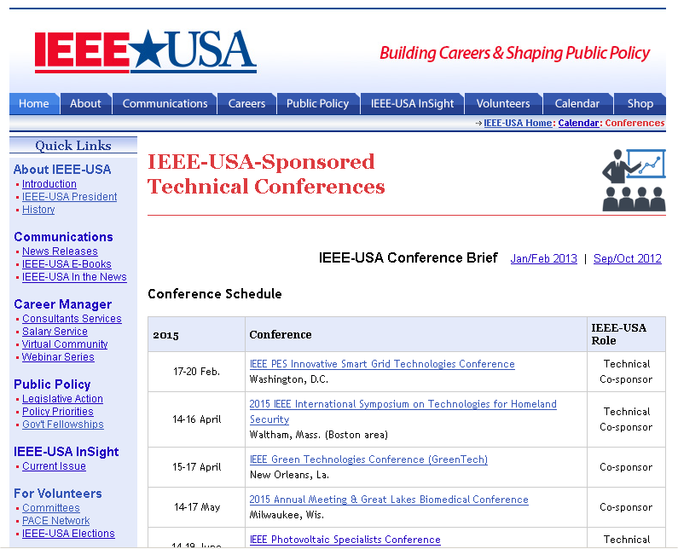
IEEE-USA Conference Calendar with link to IEEE-USA ConferenceBrief
http://ieeeusa.org/conferences

Slide 23
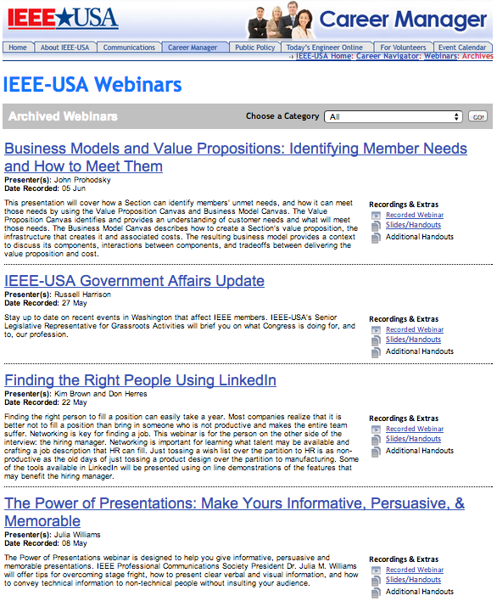
WEBINARS: Other Convening Options for Members, Student & Young Professionals
How to Win in a Competitive Job Market
Interviewing Types and Preparation
Finding a Job that Fits Skills and Interests
Consulting 101
Mentoring: Your Career's Competitive Advantage
Exploring Career Options
Networking Solutions for Career Success
ieeeusa.org/careers/webinars

Slide 24
Student Professional Activities (SPA|x) and Future Leaders Forum
http://ieeeusa.org/volunteers/committees/spax
2018 Future Leaders Forum
July 2018
Austin, TX
Students, Young Professionals, Industry
Professional, Technical, Career Fair, K-12 STEM

Slide 25
An IEEE-USA Conference Proposal
What about a
Jointly sponsored
IEEE-USA/Region
Conference
for YOUR Section!

Slide 26
IEEE-USA Conference Services
The mission of IEEE-USA Conferences Committee is to implement conference programs specifically intended to serve and benefit the members, the profession, and the public in the United States and especially those in public policy areas
In meeting that charge, the IEEE-USA Conferences Committee works with regional and local Conference Organizers to develop new conferences and support existing Regional Conferences as financial (FCS) or technical (TCS) co-sponsors
See the IEEE-USA Value Proposition document at:
http://ieeeusa.org/conferences/services.pdf
For additional information, please contact Charles Rubenstein, Chair – IEEE-USA Conferences Committee:
c.rubenstein@ieee.org
Notes:
SDG

Slide 27
Questions? Need Help or Suggestions?
Please contact me:
Charles Rubenstein
Chair, IEEE-USA Conferences Committee
c.rubenstein@ieee.org
Visit the IEEE-USA Conferences web site at:
http://www.ieeeusa.org/conferences

