Slide 1
IEEE Region 1 Treasurer’s Report
Bala Prasanna
bprasanna@ieee.org
Region ExCom & BOG Meeting @ White Plains, NY
10-11 August 2018

Slide 2
Financial Highlights
2018 – Jan-June
Major inflow includes - $64 K Rebate & $83.5K assessment
Revenue - $168K, Expenses $54K
Systematic transfer to LTIF - $10k * 4, 2 instalments completed by July 2018
R1 Financial Audit – Audit for period ending 06/30/2018 completed on 7/27/2018,
2019 Budget– Ron Tabroff will present budget proposal (Aug 2018)
Remainder of 2018 Anticipated Major Expenses – R1EXCOM/BOG(Aug), PACE Projects, Transfer to LTIF, R1 Award related expenses, R1- Maker-Faire and other miscellaneous expenses

Slide 3
2010-2018 Networth Rebate Assessment History
 | Networth | Rebate | Assessment
2010 | $111,923
2011 | 95,515 | 68,516 | 108,516
2012 | 99,942 | 68,400 | 108,534
2013 | 183,759 | 68,400 | 104,437
2014 | 183,118 | 69,800 | 100,923
2015 | 254,559 | 68,200 | 97,374
2016 | 328,479 | 68,850 | 92,626
2017 | 380,473 | *63,537 | 89,513 |  | $5K-Bailout deducted from rebate
2018 | 498475 (6/30/2018)* | *64539 | 83,444 | Mostly complete assessment | $5K –Bail out deducted from rebate

Slide 4
2017 Section Audits & 2018 Netsuite Updates
2017 – Please complete audits of your section financials no later than 6/30/2018. Area Chairs to confirm with Section chairs and report to R1 treasurer & Director
2018 –Netsuite Updates – Quarterly (April, July, Oct & Jan(2019))
IEEE Financial Audit Policy
All Regions will have to have audits done regardless of balance.
Sections threshold is $250K. If the chapters are rolling up to the Section financials, they will be reviewed in the Section audit.
Any section can be randomly picked for an audit regardless of balance
Region 1 asks the sections to have an audit once a year completed by March of the following year.

Slide 5
2017 Section Audits

Slide 6
IEEE Guidance Regarding Vendor Contracts
All signed contracts should be submitted to IEEE Conference Contracting Services for central retention.
Contract(s) valued $25,000 USD or more should be submitted to IEEE Conference Contracting Services for review, approval, and executed by an authorized IEEE signer.
Agreement(s) valued $5,000 USD or greater should have a contract in place. We recommend informing and consulting with IEEE’s Legal and Contracting Services when procuring hoteling and catering, or professional services, to reduce financial or legal risks to the organization.
https://www.ieee.org/content/dam/ieee-org/ieee/web/org/about/whatis/ieee-policies.pdf - See IEEE Policy 10.1.18
https://www.ieee.org/content/dam/ieee-org/ieee/web/org/financial-ops-manual.pdf -See FOM 8
Caitlyn Chow – IEEE Senior Internal Auditor c.chow@ieee.org

Slide 7
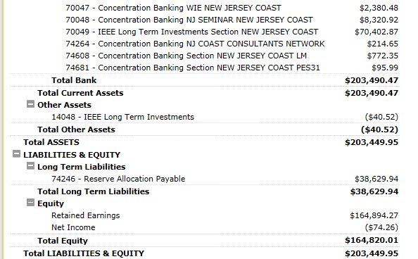
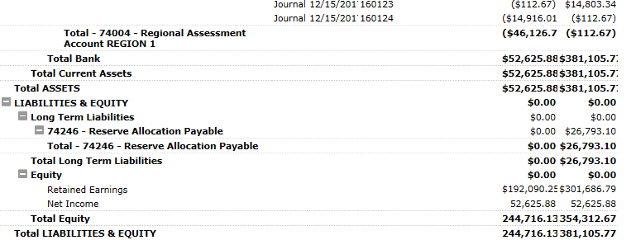
IEEE Reserve Allocation Payable

Slide 8
IEEE Reserve Allocation Payable
The liability is based on an IEEE Level calculation that seeks to apply to all OU's a share to cover any Foundation, New Initiatives and Pension Liability at the overall IEEE Level. Annually, it cannot be determined until year end once the final expenses and investment returns used in the calculation are determined. The % applied to each OU and to each section in MGA is determined based on the section share of reserves compared to total reserves. A few years ago the Board agreed to the new algorithm and it posts a liability but does not move cash from Geo Units accounts. The only way the cash is touched is if the entire IEEE exhausts all its corporate reserves. It could be reversed if NIC and Foundation spending is eliminated, but that is not likely.
FYI, no reserve allocation has been posted to the Geo Units’ financials since 2016. – Teresa Sacks MGA

Slide 9
MGA Contacts
MGA Contacts:
(Netsuite/Rebates/Bonus) Teresa Sacks t.sacks@ieee.org
(Audits)Caitlyn Chow Caitlyn.chow@ieee.org
(Concentration Banking) Stacy Negron-Sheckells s.negron-sheckells@ieee.org
Vtools Marguerite Gargiula m.gargiula@ieee.org
Timely Netsuite Uploads – Quarterly
Annual Reporting must be completed by second Fri in Feb for previous year to be eligible for section rebate, Recommendation is to complete by end of Jan .
Financial Audits – Annually by March month.

Slide 10
Timeliness and Readability of Expense Reports
Stay within your budget allocations
BOG Expense reports due to Aug mtg must be submitted no Later than Friday-8/24 (bprasanna@ieee.org). Reimbursements will be completed by 9/1
Reports missing this deadline will be escalated to R1 Director, and reimbursements may be delayed.
All reports must be in pdf/Excel format, receipts must be readable and identifies with corresponding entry on expense report. Reports must have mandatory fields filled-in. Reports not meeting these guidelines will be returned, and reimbursement may be delayed.
SC-2017 Expense Reports
Took several iterations in many cases to get a just-acceptable report
Several reminders sent to meet deadline
Several currency-conversion, receipts, guideline-breaking cases
Ron Tabroff & I had lengthy discussions in a few cases.
Settled with MGA amicably

Slide 11
Expense Reporting Guidelines
Rental Car/Air Travel - Must obtain approval from R1 director prior to travel, and submit copy of approval to treasurer along with the expense report.
Receipts for gas/Taxis must be included even if it is less than $25
Be sure to state the purpose of trip in the expense report. Reports without a stated purpose will be returned.
If the expenses do not appear to be reasonable, R1 director will be asked to examine and approve.
Please be sure to check your reports are clear, legible, and include explanations where warranted. (I get jpgs of receipts that requires a super magnifying glass to read, or the expenses claimed are included/hidden in various places making it less obvious where the expenses came from.
Expense reports must be submitted within 2 weeks of the expense.
Thank you for your cooperation

Slide 12
IEEE REGION 1 Expense Reimbursements Deadline – 8/24/2018
bprasanna@ieee.org
or
Bala Prasanna,
IEEE R1 Treasurer
8 Chardonnay Dr.
Holmdel, NJ 07733
“Thank You”

