Slide 1
Information Management Report
Greg Gdowski
Information Management Report (Greg.gdowski@gmail.com)

Slide 2
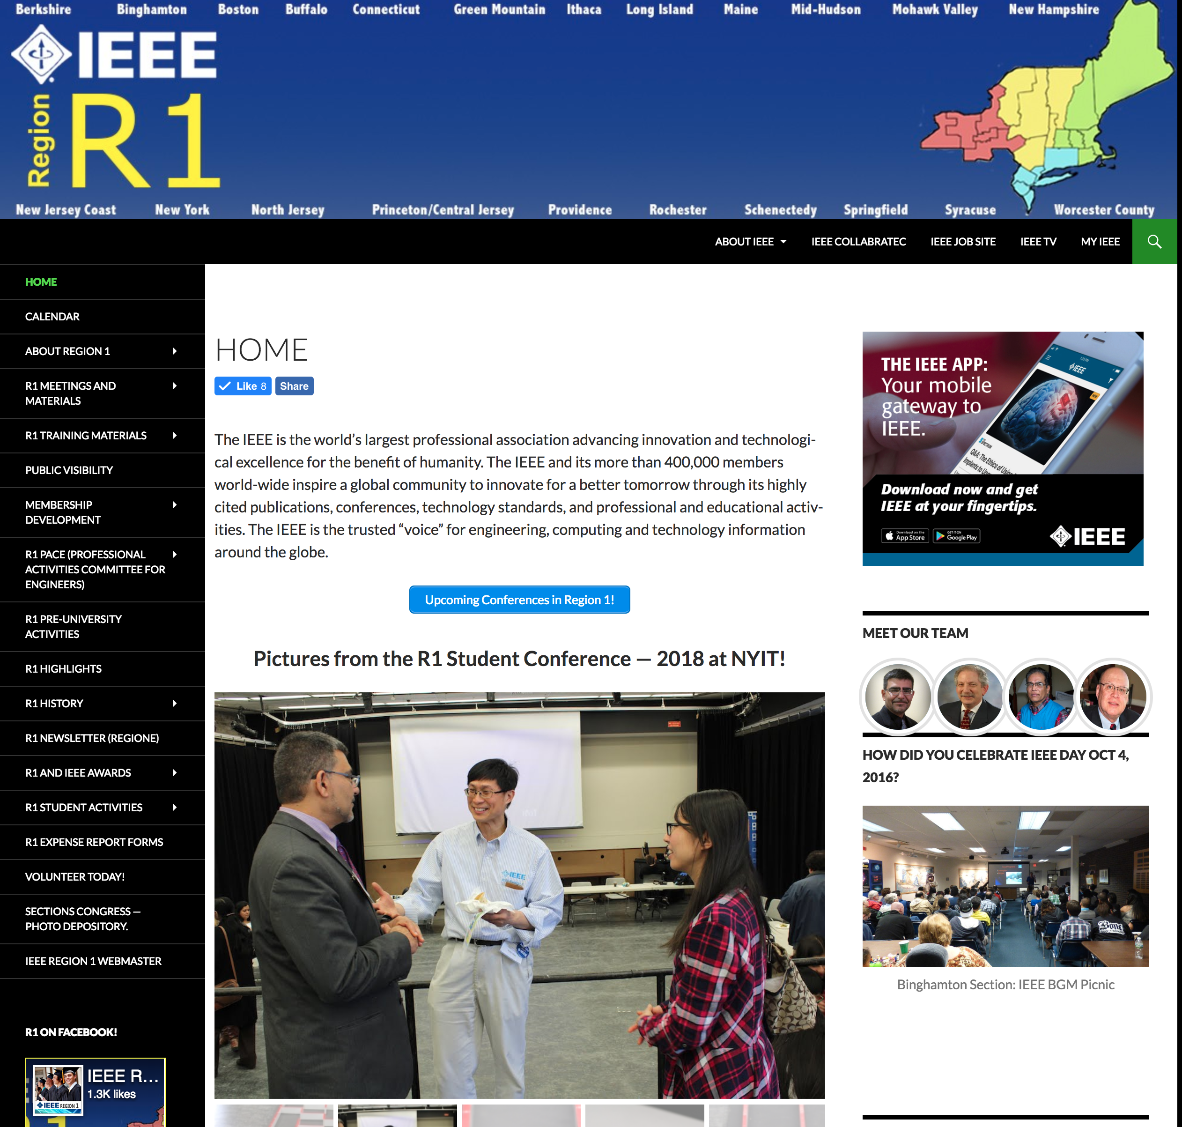
Webpage Contents
http://sites.ieee.org/r1/
Overall layout of the webpage is stable
Added promotions for IEEE App
Modified long term storage of data for Excom and BoG meetings
Modified all officers across the region. This includes photos and contact information
Added training documents of training sessions
Added the ability to use Paypal via gravity forms within our web pages. This pays directly to our R1 Concentration account.
Enhanced registration for BoG meeting. Will be used in the future for student meetings.
Information Management Report (Greg.gdowski@gmail.com)

Slide 3
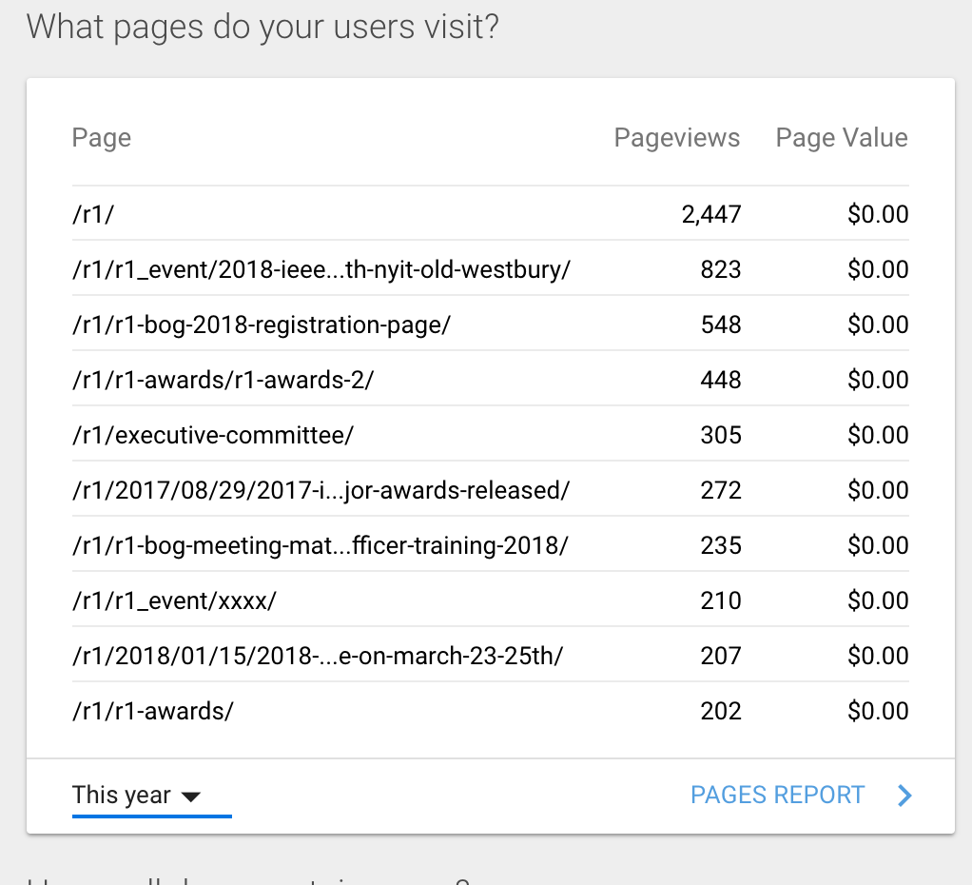
Most activity during R1 student conference
Information Management Report (Greg.gdowski@gmail.com)

Slide 4
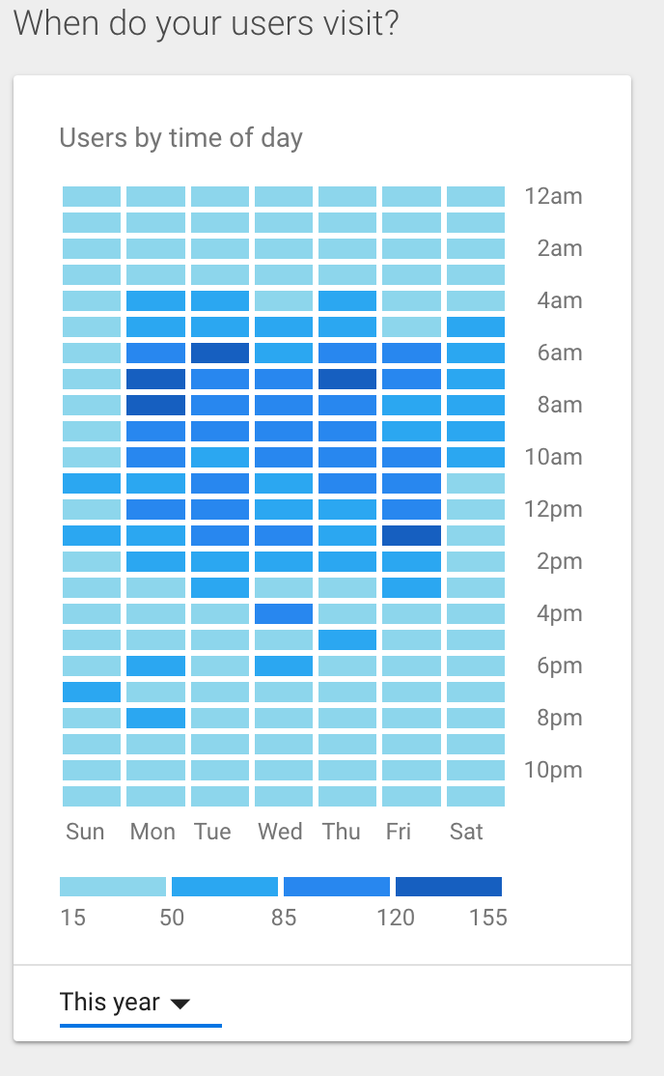
Webpage Utilization
Most users visit the pages between 6-8am.
The majority of usage is in the early mid-morning period
Information Management Report (Greg.gdowski@gmail.com)

Slide 5
Maintain and manage all R1 IEEE listserves.
R1-SECTION-CHAIRS@IEEE.ORG
R1-NORTH@IEEE.ORG
R1-CENTRAL@IEEE.ORG
R1-WESTERN-AREA@IEEE.ORG
R1-SOUTH@IEEE.ORG
Information Management Report (Greg.gdowski@gmail.com)

Slide 6
Other activities
Managed the web delivery of the two R1 training sessions in 2018.
Provided vtools training in the spring, and at the R1 Board of Governors meeting in August.
Relayed and provided communication support for the region.
Provided support for advertising many events, including the R1 Student Conference.

Slide 7
Questions? Thank you!
Information Management Report (Greg.gdowski@gmail.com)

