Slide 1
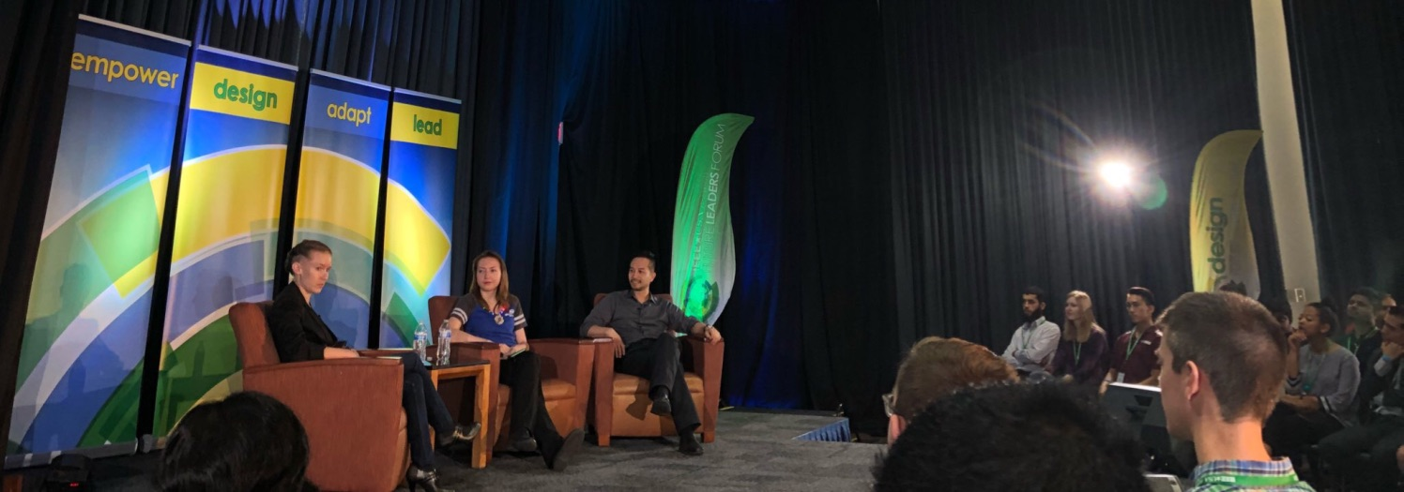
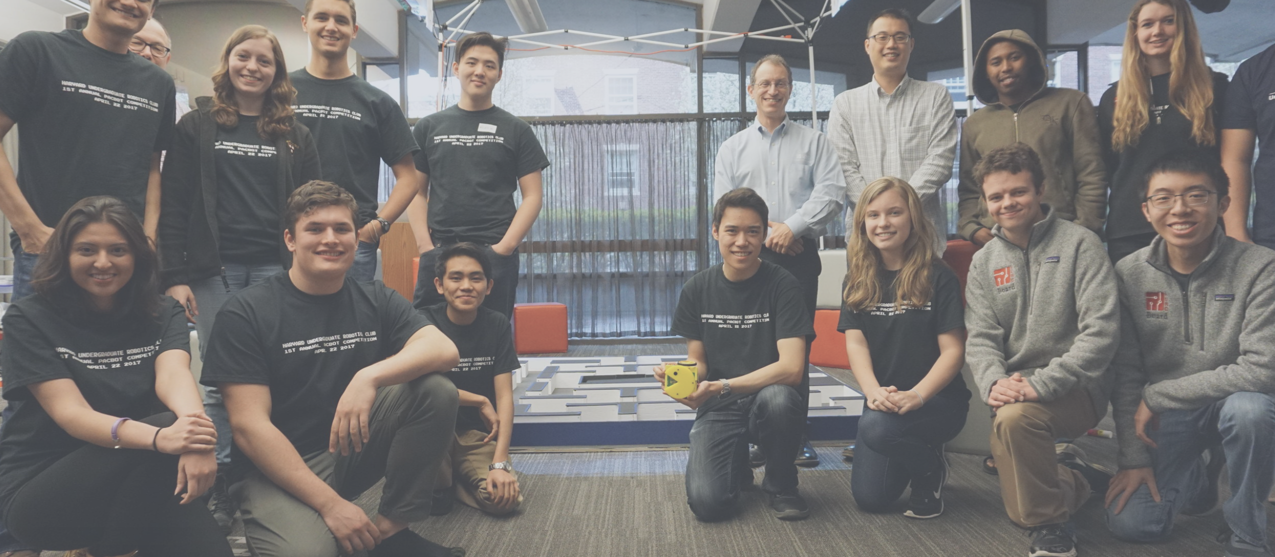
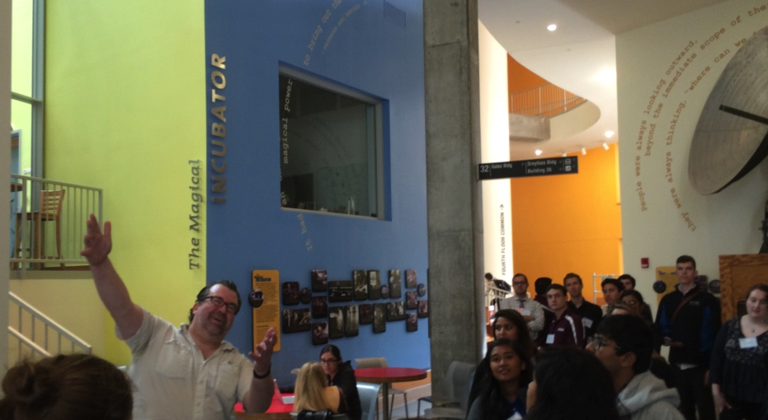
Region 1 – White Plains Meeting Student Activities & Section Engagement
Bruce Hecht (bruce.hecht@ieee.org), R1 SPAx Chair
George Bertnsen – Connecticut Section Co-Chair
Kathleen Kramer – Session Facilitator, R6 Director
11 August 2018

Slide 2
Questions for Action
What are the goals for Sections engagement with students?
How might we improve communication with student branches? IEEE systems?
What is the MGA strategy for Student Branches and Sections?
What are the priorities for Region 1 for student engagement?
What new initiatives do we want to sponsor? Student Leaders & Sections

Slide 3
Resources and Current Activities
Region One Student Conference
Undergraduate Research Technology Conference – co-organized by the MIT Student Branch and the Boston Section
Engagement at Section conferences
OU Analytics – how best to leverage?
Google Sheets notes and ideas:
https://goo.gl/1UfMZp

Slide 4
Recommendations for Action
Gain clarity about IEEE MGA student branch communication
Identify Region 1 strategies for Student, Section & Region engagement
Data Systems
Communication and Reporting
Executive Sponsorship and Engagement with Schools
Establish training for branch counselors and student leaders

Slide 5
Next steps: Future Events & Engagement
Contact:
Bruce.Hecht@ieee.org
Bruce.Hecht@analog.com +1-781-937-1535

