Slide 1
North Jersey Section Report
Kalyan Mondal, Chair
North Jersey Section Report

Slide 2
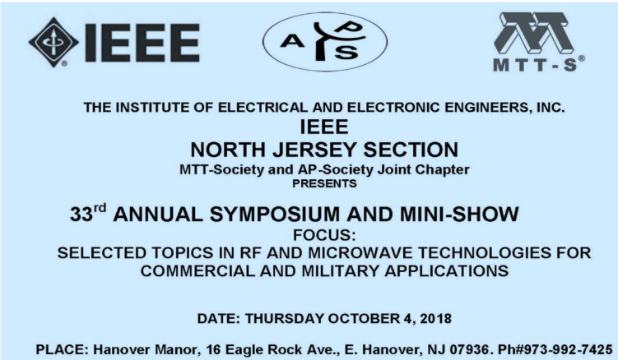
16 Active Society Chapters
Aerospace & Electronics System (AES)
Antenna Propagation/Microwave Theory & Technique (AP/MTT): Organizes highly successful annual Symposium & Mini-show
Circuits and Systems (CAS)

Slide 3
16 Active Society Chapters (continued)
Communications (COMM): Organizes annual NJ Advanced Communication Symposium, offers training courses

Slide 4
16 Active Society Chapters (continued)
Computer (C)
Control (CS): Starting to offer two new training courses, sponsoring 2019 IEEE Drone for Infrastructure Symposium
Drones for Infrastructure A Technical Workshop

Slide 5
16 Active Society Chapters (continued)
Electromagnetic Compatibility/Product Safety Engineering (EMC/PSE)
Technology & Engineering Management (TEM)
Industrial Applications (IA)
Information Theory (IT): Sponsors Shannon Lecture Series at Nokia Bell Labs
Instrumentation & Measurement (IMS)
Photonics (PHO):
Power and Energy (PES): Organizes highly successful seminars offering CEUs towards PE licenses
Signal Processing (SP)
Systems, Man, and Cybernetics (SMC)
Vehicular Technology (VT)

Slide 6
Affinity Group & Committee Activities
Pre-University Committee
Offers highly subscribed STEM courses for School students
Sponsored 2018 NJ makers fair at Oradell Public Library
Student Activities Council (SAC)
Organizes student paper competitions leading to R1 award winners
History Committee
Successfully instituted several Milestones at Bell Labs
Education Committee
Offers multiple training courses throughout the year
Issue of low attendance
Program Review Committee
Developed preliminary guidelines for reviewing external event sponsorship requests

Slide 7
Section Financials
Since 2012, one of the first Section adapters of Netsuite for accounting
Very sound bookkeeping with passing audit records year after year since 2012
Under expensed every year since 2013
CBRS account balance has steadily grown since 2012 due to proper fiscal management

