Slide 1
R1 vTools Training Session
Greg Gdowski
R1 Information Management Coordinator & Webmaster
Greg.gdowski@gmail.com

Slide 2
Topics for today: 1. Officer reporting 2. Creating Events 3. Creating Enotices

Slide 3
vTools at a Glance http://sites.ieee.org/vtools/
Technology Support for Volunteer Leaders
vTools.OfficerReporting (https://officers.vtools.ieee.org)
vTools.Meetings (https://meetings.vtools.ieee.org/main)
vTools.StudentBranchReporting (https://sbr.vtools.ieee.org/)
eNotice (http://enotice.vtools.ieee.org/)

Slide 4
vTools.OfficerReporting https://officers.vtools.ieee.org/
Purpose: To enables authorized volunteers to submit officer change reports.
Updates the central IEEE database
Volunteers can view/add/remove/update officers.
OfficerReporting Tutorials :
sites.ieee.org/vtools/documents/2013/10/online-officer-reporting.pptx or
sites.ieee.org/vtools/documents/2013/10/online-officer-reporting-pdf.pdf

Slide 5
Reporting Officers via vTools
Full
Position
Organizational
Organizational
Position
Position
Name
Description
Type
Unit Name
Start Date
End Date
Greg T
Chair
Section
Syracuse
01/01/2012
12/31/2012
Gdowski
Section
Greg T
Chapter Chair
Chapter
Rochester
01/01/2009
12/31/2010
Gdowski
Section
Chapter,EMB18
Greg T
Chair
Section
Rochester
01/01/2014
12/31/2017
Gdowski
SAMIEEE
Section
Section
01/01/2018
Why bother?
History of leadership activity
RECIPIENT
Vice Chair
Section
01/04/2010
12/31/2010
02/25/2013
12/31/2013
Webmaster
Section
08/01/2015
12/31/2016
vTools
Section
01/01/2018
12/31/2019
Coordinator
Greg T
Area Chair
Region
Northeastern
12/31/2017
Gdowski
Electronic
Region
USA - Region 1
01/01/2016
12/31/2018
Communications
Coordinator
Information
Region
01/01/2018
12/31/2018
Management
Coordinator
SAMIEEE
Region
01/01/2018
12/31/2018
RECIPIENT
SAMIEEE User -
Region
01/01/2018
Full Access
Webmaster
Region
01/01/2016
12/31/2018
vTools
Region
12/01/2017
Coordinator

Slide 6
Reporting Officers via vTools
Why bother?
Officers are searchable through OU Analytics
Members get credit for being an officer!
Active | Jeffrey | Pink | Senior Member | 31-Dec-03 | 1-Jan-03
Active | J | Schanker | Life Senior | 31-Dec-04 | 1-Jan-04
Deceased | Kenneth | Arnold | Senior Member | 31-Dec-06 | 1-Jan-05
Active | Gaurav | Sharma | Fellow | 31-Dec-07 | 1-Jan-07
Active | Jayanti | Venkataraman | Life Senior | 31-Dec-08 | 1-Jan-08
Active | Paul | Lee | Life Fellow | 4-Jan-10 | 1-Jan-09
Active | Alexander | Loui | Fellow | 31-Dec-11 | 4-Jan-10
Active | William | Fowlkes | Senior Member | 31-Dec-13 | 1-Jan-12
Active | Greg | Gdowski | Senior Member | 31-Dec-17 | 1-Jan-14

Slide 7
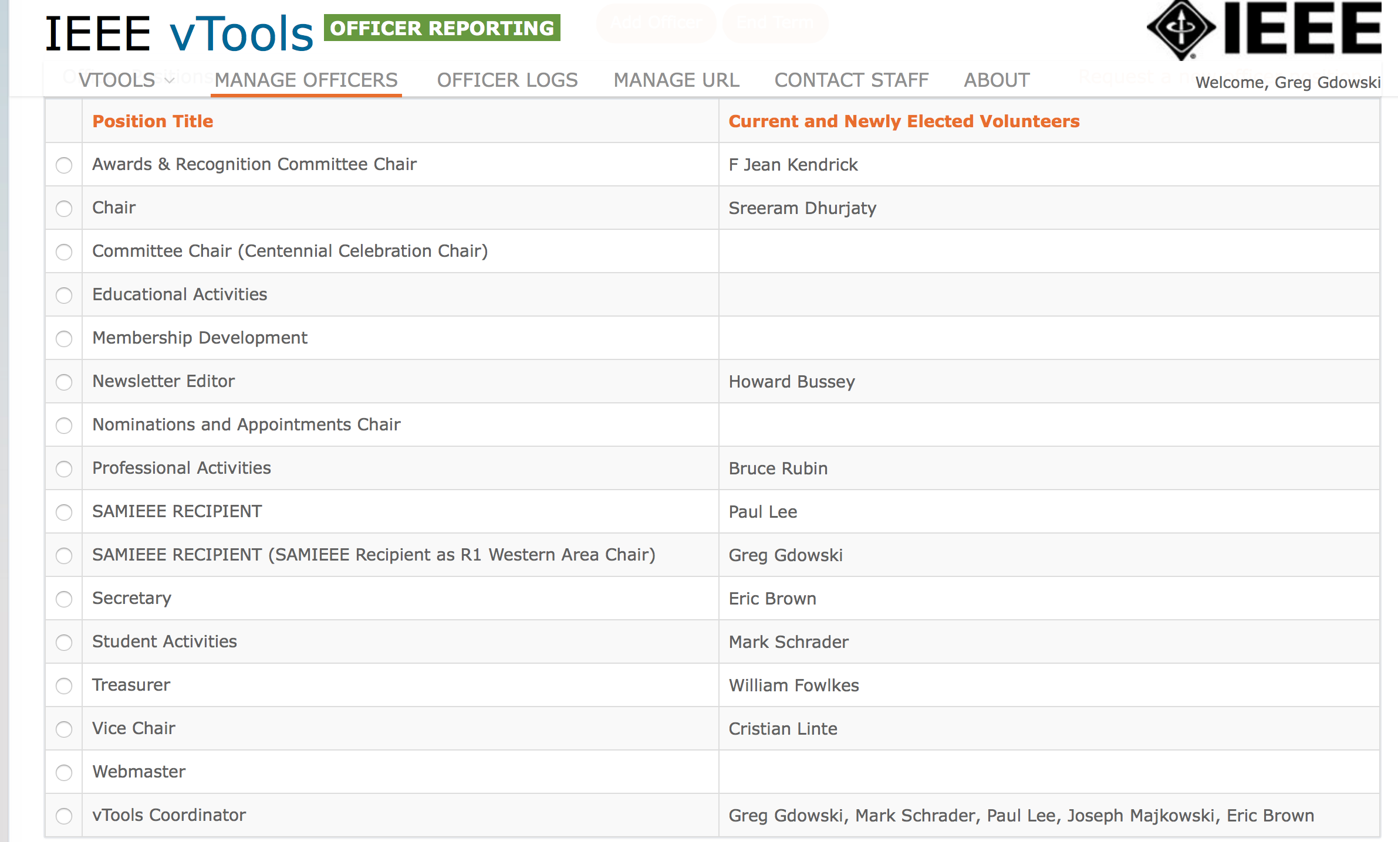
Reporting Officers via vTools
Why bother?
Defines who has access to OU Analytics
Defines who has the ability to create meetings and send notices!

Slide 8
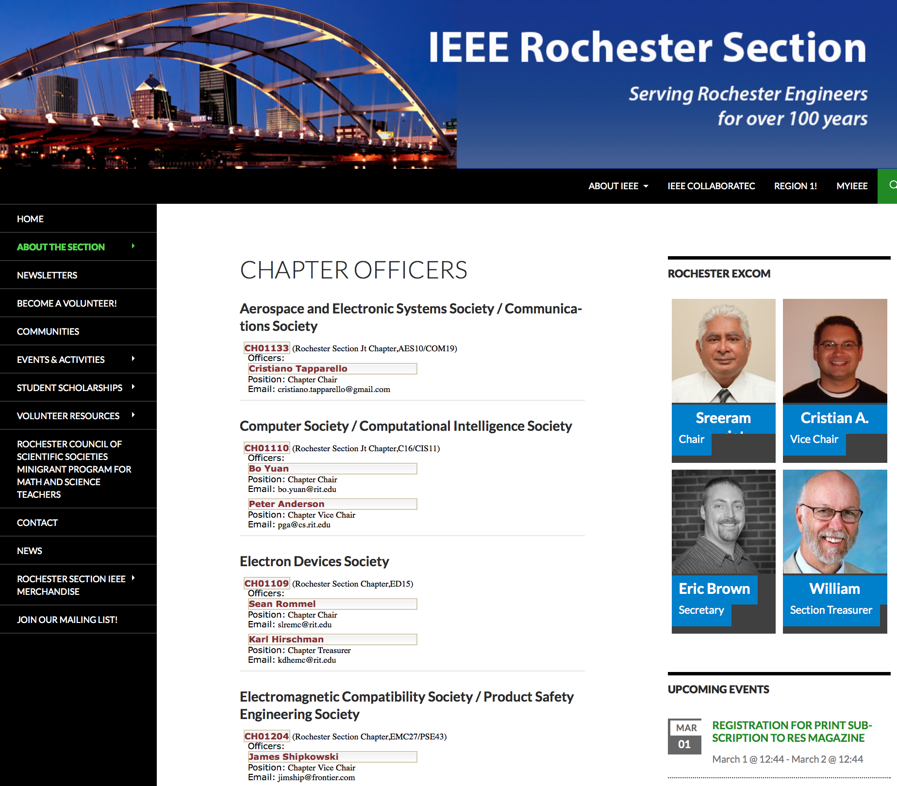
Reporting Officers via vTools
Why bother?
Web officer widget for web pages!
Automatic feed direct from OU Analytics
Maintenance FREE!

Slide 9
Reporting Officers via vTools
Navigate to https://officers.vtools.ieee.org
Things you can do
Manage and assign Officers
Obtain log of officer changes

Slide 10
Reporting Officers via vTools
Navigate to https://officers.vtools.ieee.org
1
2
Getting started
Sign in to the system
Click on Manage Officers

Slide 11
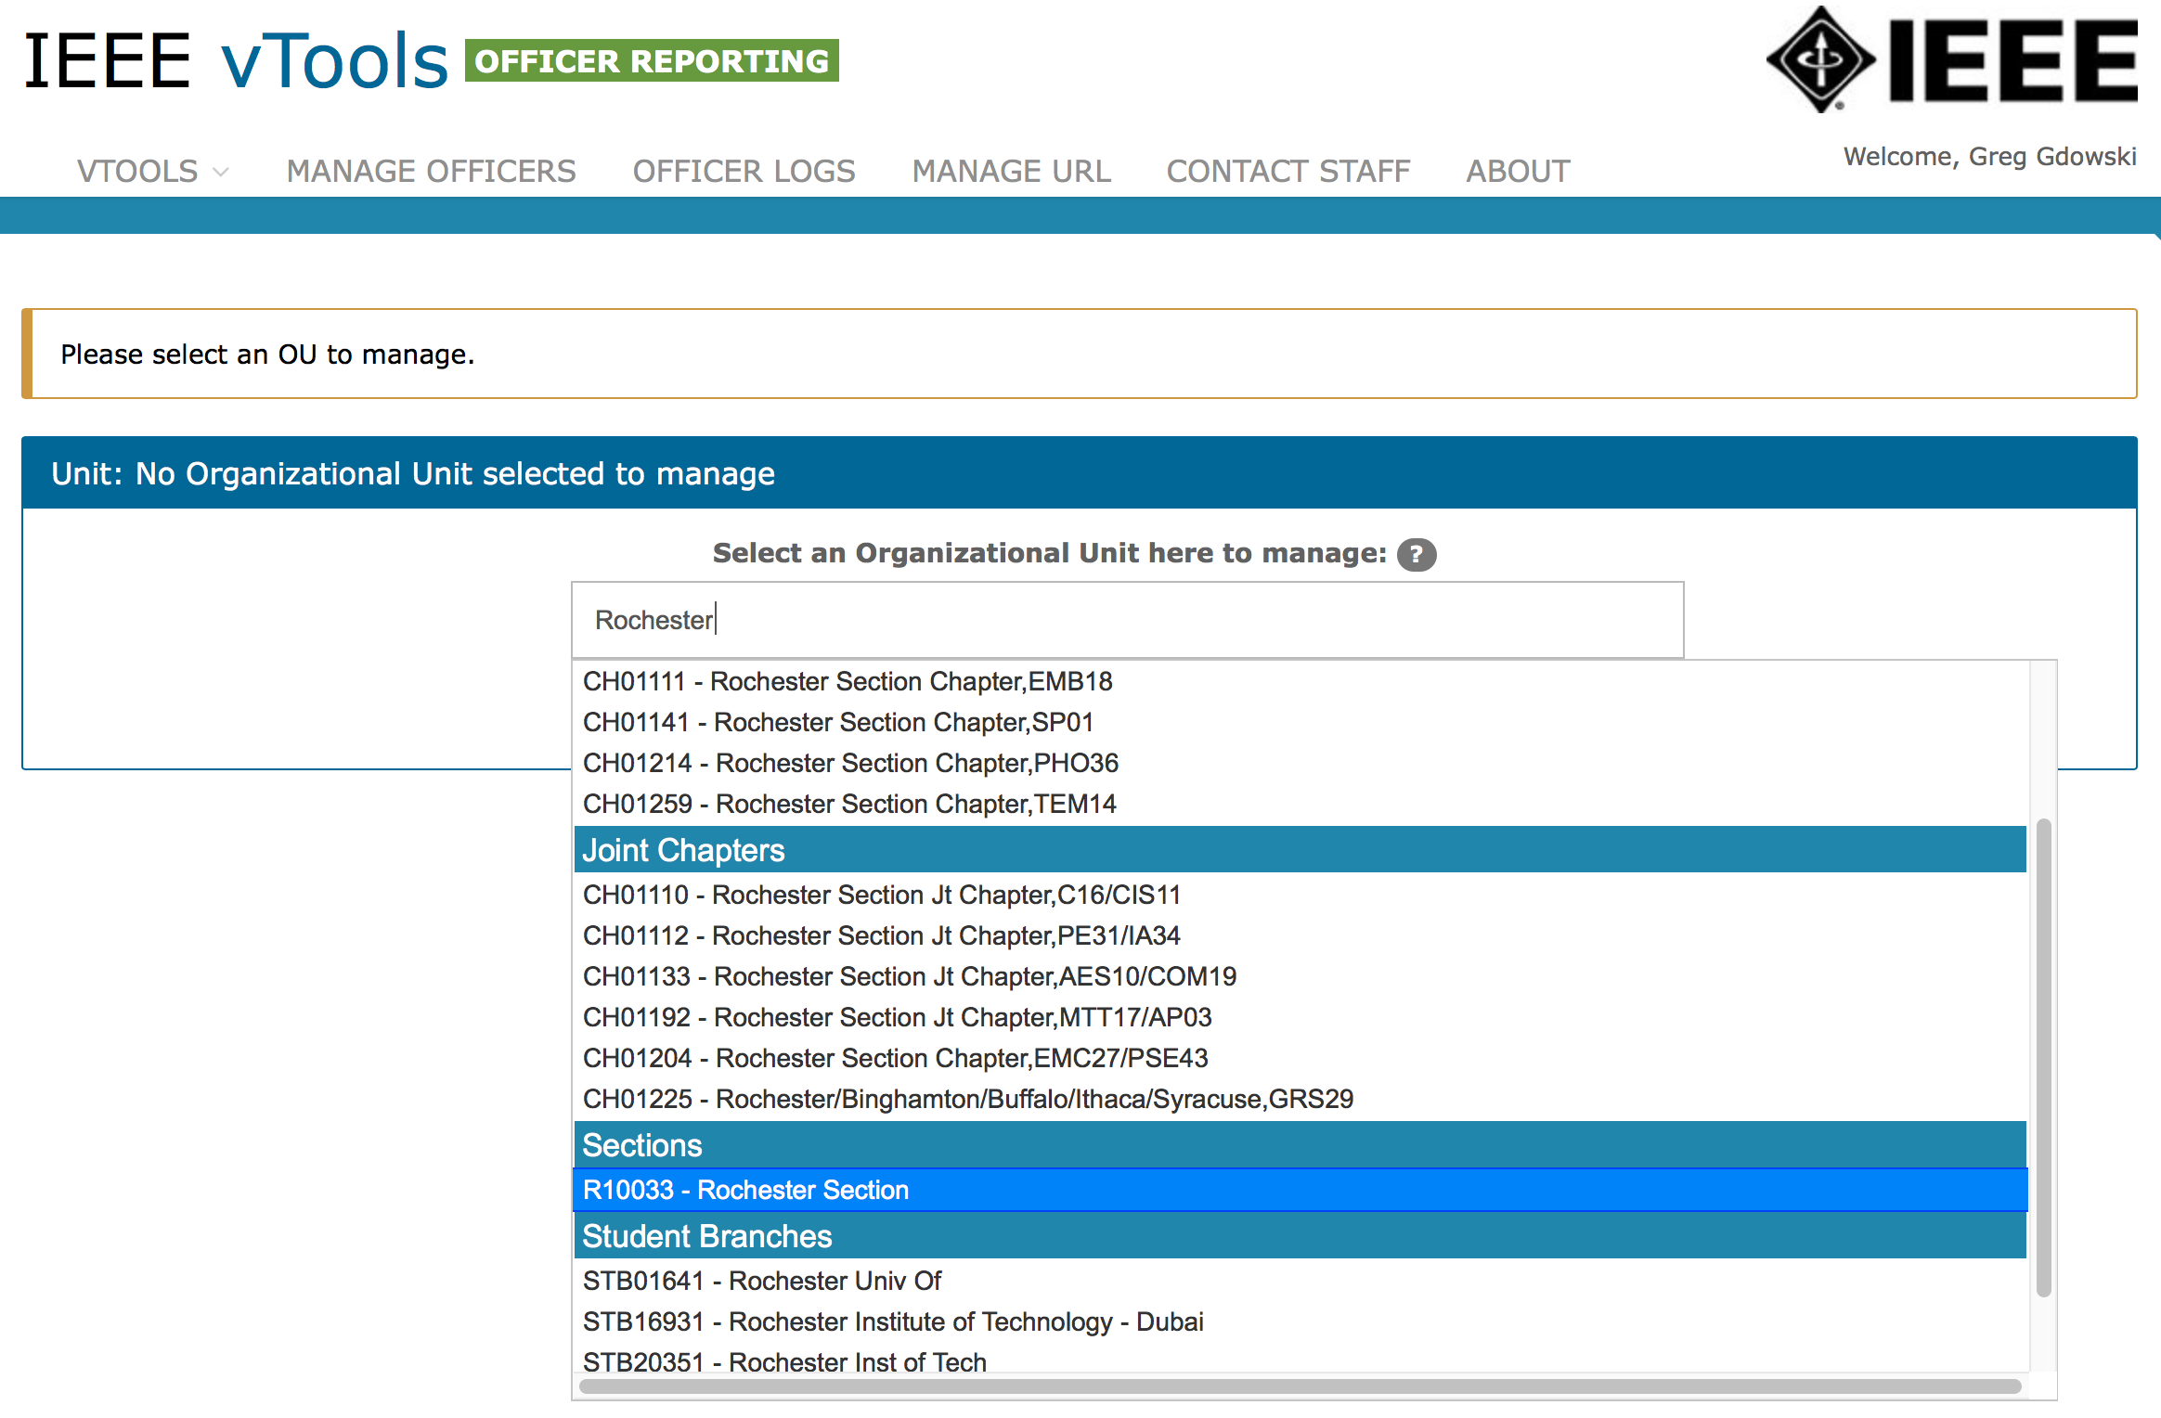
1. Type in your Section Name in the box 2. A list will be generated automatically. 3. Select your Organizational Unit 4. Hit Select Button (not shown)
1
2
3

Slide 12
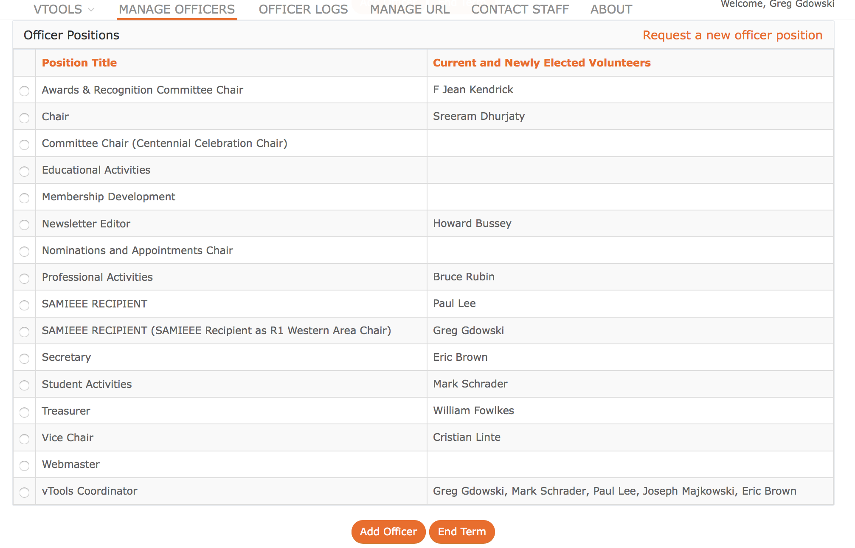
1. Current Officers are shown 2. You can either add an officer or end the term of an existing officer.
Click on an officer position to add new person
1
2
Click on Add Officer
3

Slide 13
1. Add Officer’s IEEE member number
2. Add a term start date
3. Hit Submit button

Slide 14
2. Confirm Pending Changes!
1. New Officer will be highlighted

Slide 15
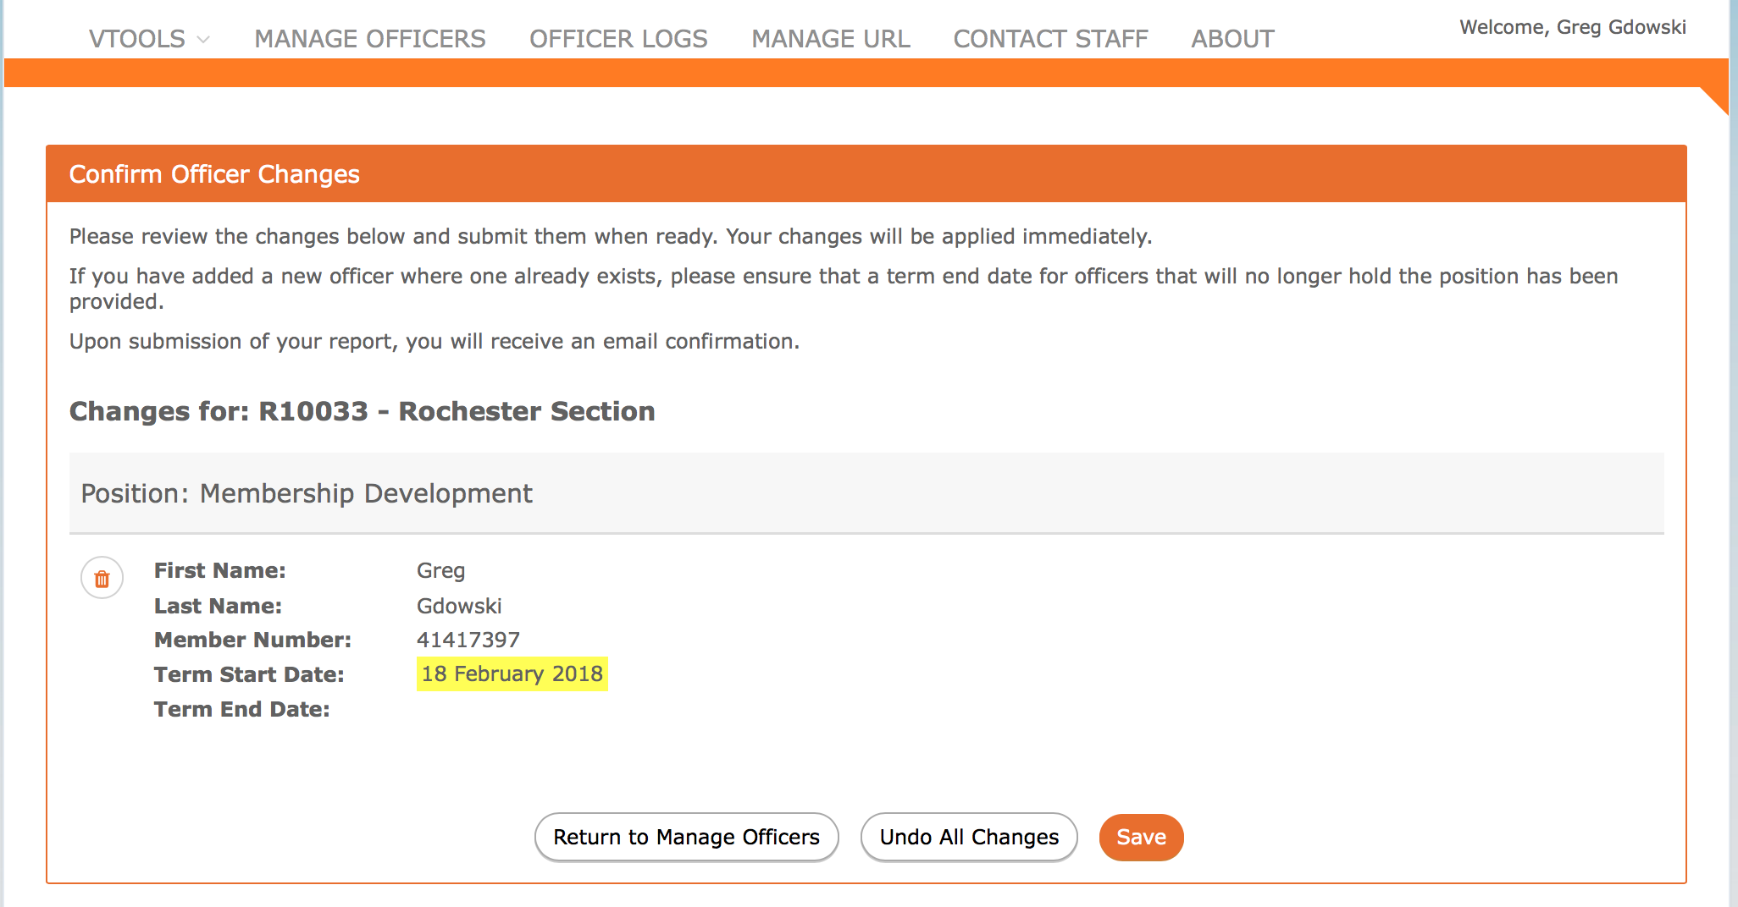
Yes, it really is that easy!
Reporting Officers via vTools
If you are an officer of the organizational unit in which this report is for, your changes will be made immediately. Otherwise, changes will be reviewed by staff before taking effect.
3. A confirmation email will be sent.
1. Confirm Changes were entered correctly
2. Hit Save to submit report

Slide 16
Topics for today: 1. Officer reporting 2. Creating Events 3. Creating Enotices

Slide 17
vTools – Events (meetings)
Why bother?
1. All Section events are put on the R1 Web pages calendar.
These are put on the web pages automatically!!
Do not ask me to edit entries – they must be edited by you in vtools!

Slide 18
vTools – Events (meetings)
Why bother?
1. In Rochester, Section Events also get put on their webpages.
This is also done automatically after the meeting is entered in vtools

Slide 19
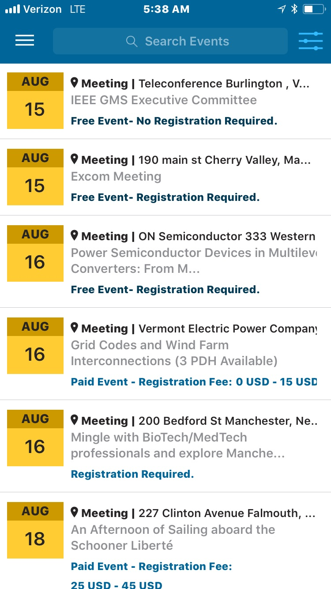
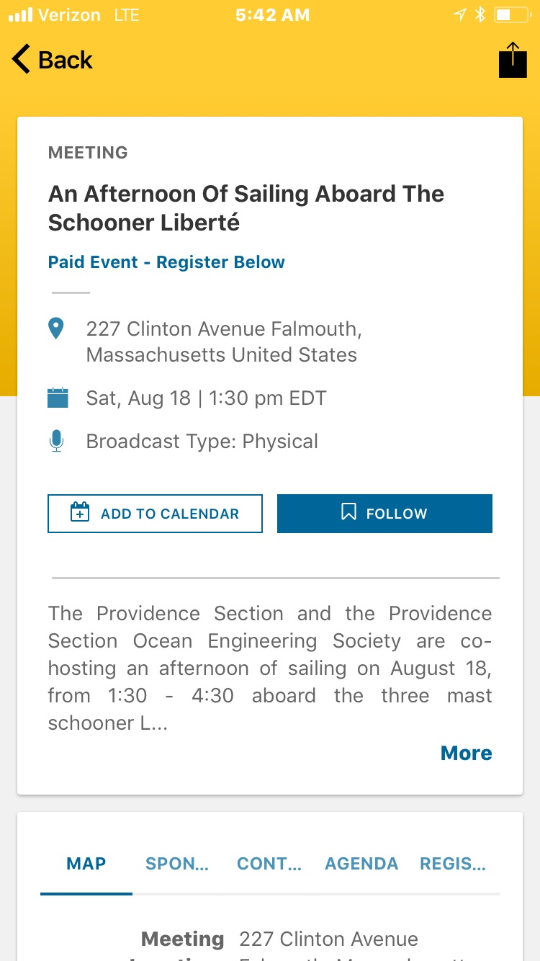
Why bother?
1. Events

Slide 20
vTools – Events (meetings)
Why bother?
Additional reasons
Create nicely formatted Enotices to members
Collect payments via paypal
Keep track of attendees
Generate L31s

Slide 21
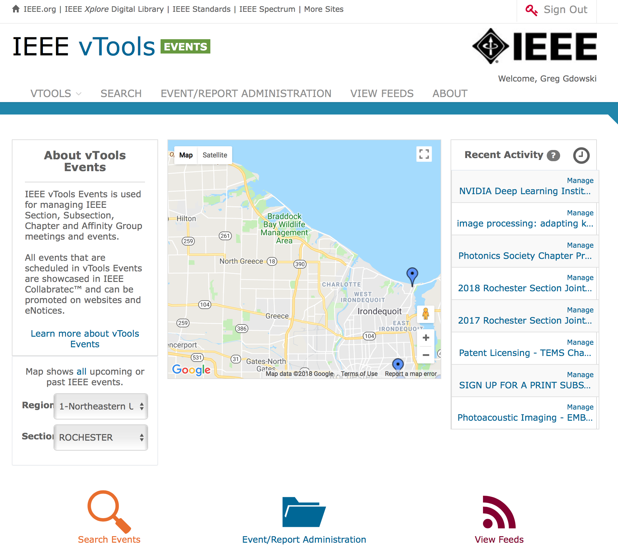
vTools – Events (meetings)
Where is it?
1. Navigate here:
https://events.vtools.ieee.org
2. Login in the upper right corner
3. Create new events!
Click on “Event/Report Administration””

Slide 23
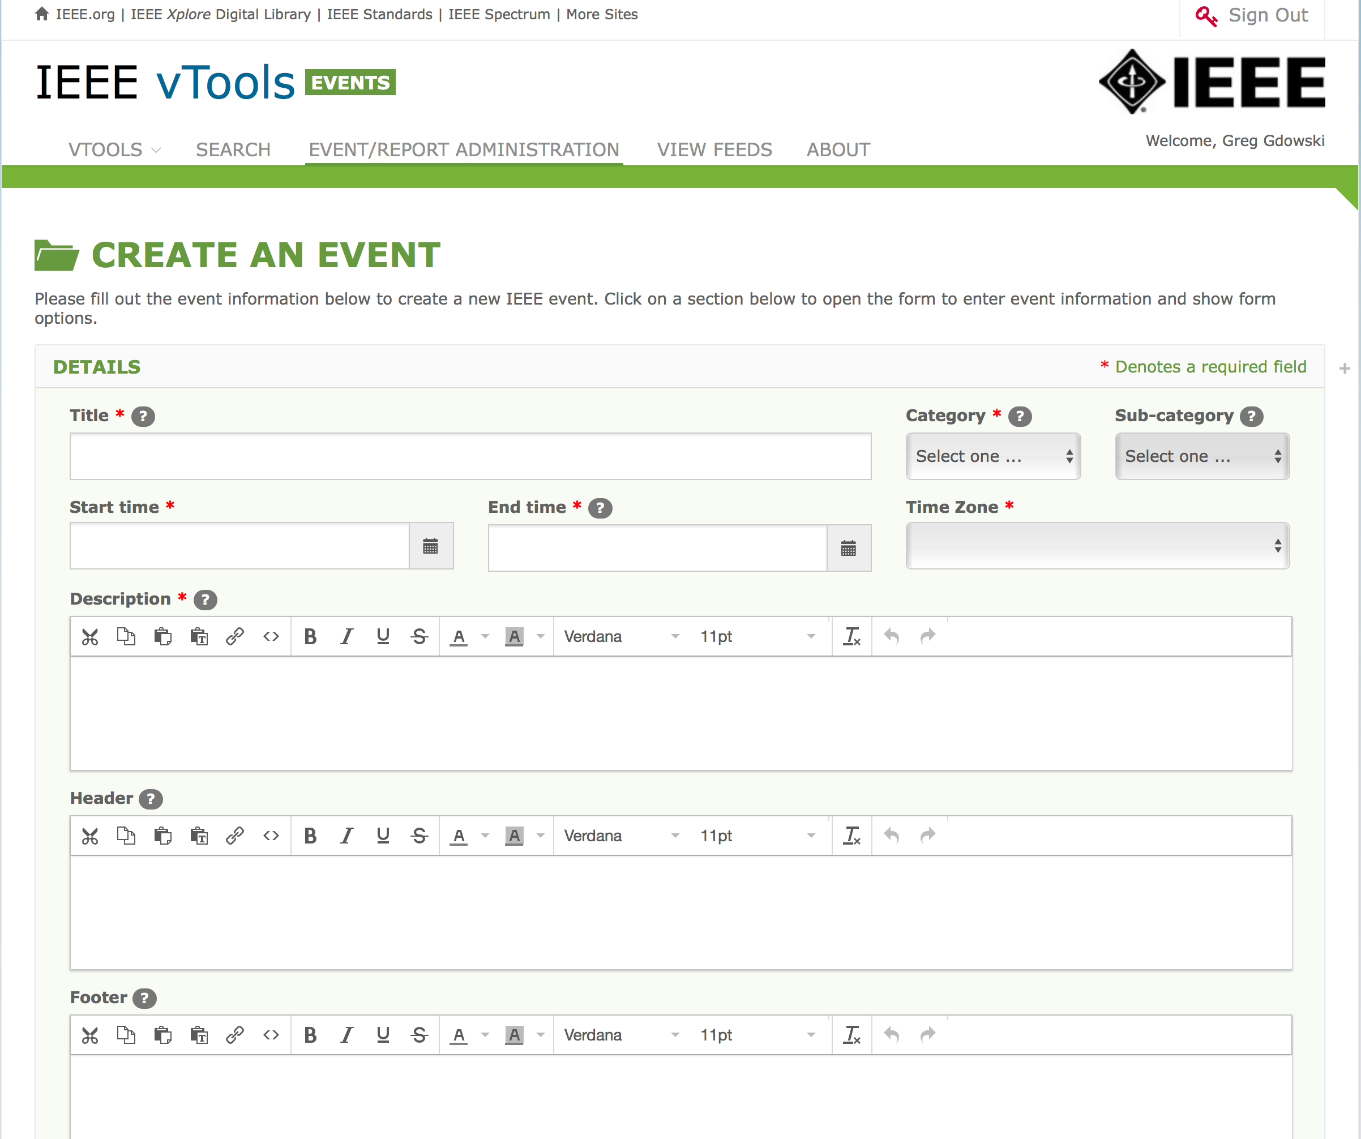

Slide 25
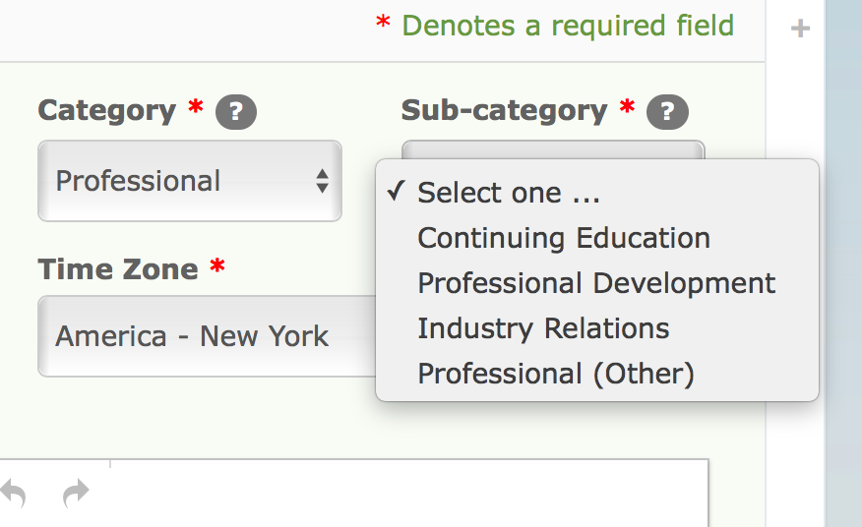
Category and Sub-categories

Slide 26
Next add: 1) Agenda 2) keywords 3) Event Picture (this is a picture on your computer) HINT: DO NOT SAVE YET!

Slide 27
Host information describes your organization! Organizational unit should fill when you click buttons (circle with minus sign).

Slide 28
R10001
Cheat sheet
Copy the number next to your section
(R10001 for Berkshire Section)
Paste that into the field box.

Slide 29
Next add: 1) Location Information (City is required) HINT: DO NOT SAVE YET!

Slide 30
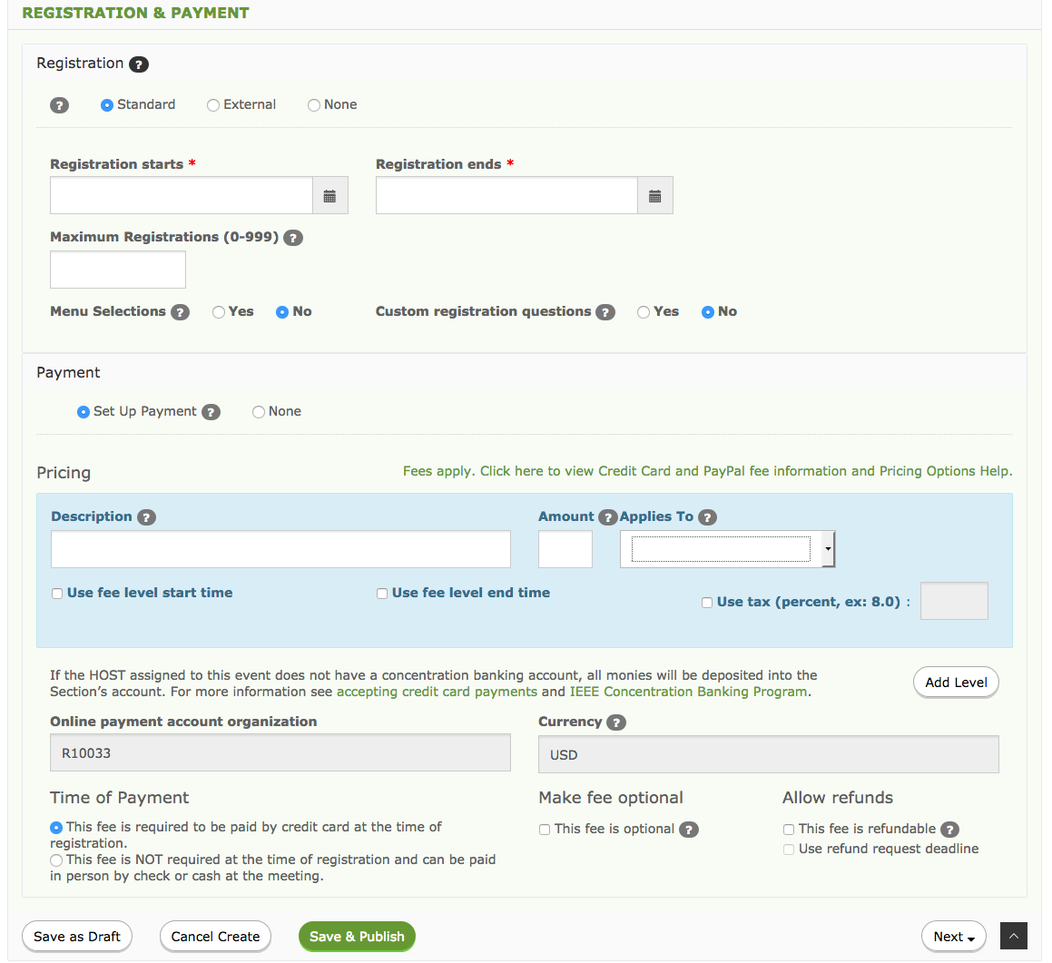
Create registrations
Can schedule payments
Can create different price schemes for different types of members

Slide 31
Add up to 2 speakers
Add their picture (must be on your computer)

Slide 32
Now you can save it!
Save as Draft -- Public but event is not placed on website calendars
Use this for private meetings. Send attendees a private emails with the link in order to register!
Save & Publish -- Public event that is placed on website calendars
Use this for public events.

Slide 33
vTools – Events (meetings)
Easy method!
1. Navigate here:
https://events.vtools.ieee.org
2. Finding existing events!
Click on “Search Events”

Slide 34
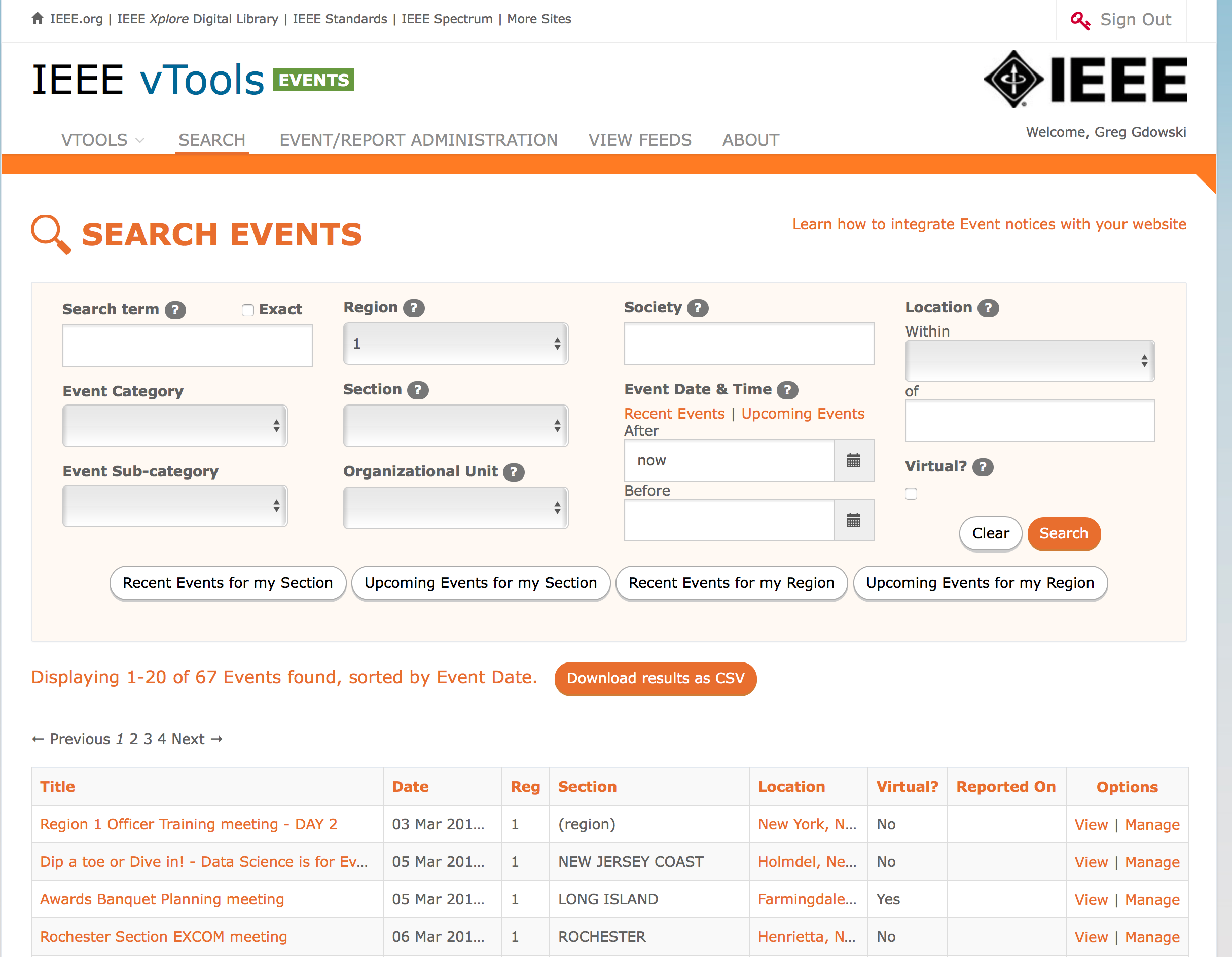
Simple search
This meeting

Slide 35
Create from existing Creating enotices from events!

Slide 36
Creating enotices from events!

Slide 37
Creating enotices from events!
There are many options for when and who you can send the notice to.
Express mail cannot have attachments, or reminders.

Slide 38
Once you hit Send Express or Submit --- You cannot edit the message without contacting IEEE You can find enotices here: https://enotice.vtools.ieee.org/mailings

Slide 39
vTools.OfficerReporting https://officers.vtools.ieee.org/
Purpose: To enables authorized volunteers to submit officer change reports.
Updates the central IEEE database
Volunteers can view/add/remove/update officers.
OfficerReporting Tutorials :
sites.ieee.org/vtools/documents/2013/10/online-officer-reporting.pptx or
sites.ieee.org/vtools/documents/2013/10/online-officer-reporting-pdf.pdf

Slide 40
PRESENTS
Getting Started with vTools

