Slide 1
Ithaca Section Report
Executive Committee Members:
Alex Specker – Chair
Hugh Philipp – Vice Chair
Jim Groves – Treasurer
Kirkland Smith – Secretary
Mike Joyner – Events Coordinator

Slide 2
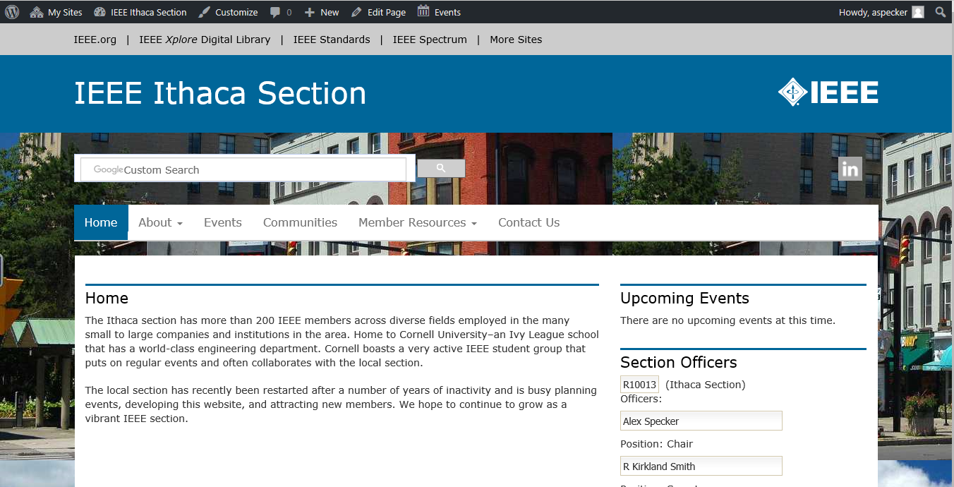

Slide 3
A Little About Ithaca, NY
Part of the Finger Lakes Region, Cayuga Lake
Home to Cornell University and Ithaca College
Thriving community that’s growing
Many small hi-tech industries
200 IEEE members
Very few active with our section

Slide 4
DroneFest Event
Given by Vince Socci
Well attended by local members and their families

Slide 5
Cornell CHESS Tour
CHESS—Cornell High Energy Synchrotron Source
Produces high-intensity x-rays
Used for research in many fields

Slide 6
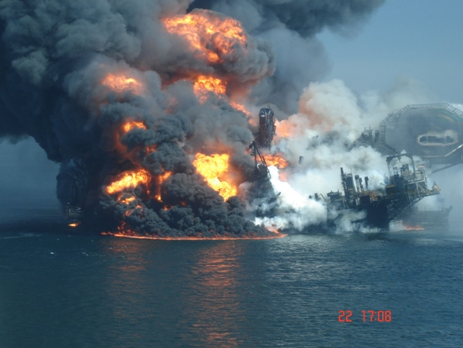
Vector Magnetics Presentation on the Deepwater Horizon/BP Disaster
Helideck

Slide 7
Relief Well
Vector Magnetics technology used to guide the drilling of the two relief wells that ultimately stopped the oil flow

Slide 8
Ithaca Section Contributions
Gave $1000 to the SC2017 held in Sydney

Slide 9
Ithaca Section Contributions
I am excited to confirm we raised the $12500 for Phase 1 to buy the solar lanterns with $1000 going direct to the section from the Ithaca Section.The recent email from Antonio to IEEE Region 9 members, and the article in the Members Benefit Bulletin and Inside IEEE for staff made a good impact. To date, we have raised a total of $16635 plus the $1000 from Ithaca Section. We still have a ways to go to get to our $37500 goal.
At this point, until we reach $37,500 goal - all the funds raised into the Fund are for the Western Puerto Rico Section project via EPICS in IEEE. So if more resources are needed - please continue to promote the activity and encourage giving.
With respect to what has been spent - I know Stacey Waters placed a solar lantern order and charged the Foundation Fund. So you need to factor that in as well.
Regards, Karen
Gave $1000 to the Puerto Rican and Caribbean section for the purchase of LED lanterns for help after hurricane Marie.

Slide 10
Future Plans
Continue with regular meetings and invite local members
Have members give presentations
Schedule more events such as plant tours, etc…
Coordinate with the Cornell Student Group
Coordinate with other nearby sections (Binghamton, Syracuse, Rochester)
Invite a DL (Distinguished Lecturer)
Look into participating in PACE and SIGHT projects

