Slide 1
Information Management Report
Greg Gdowski
Information Management Report (Greg.gdowski@gmail.com)

Slide 2
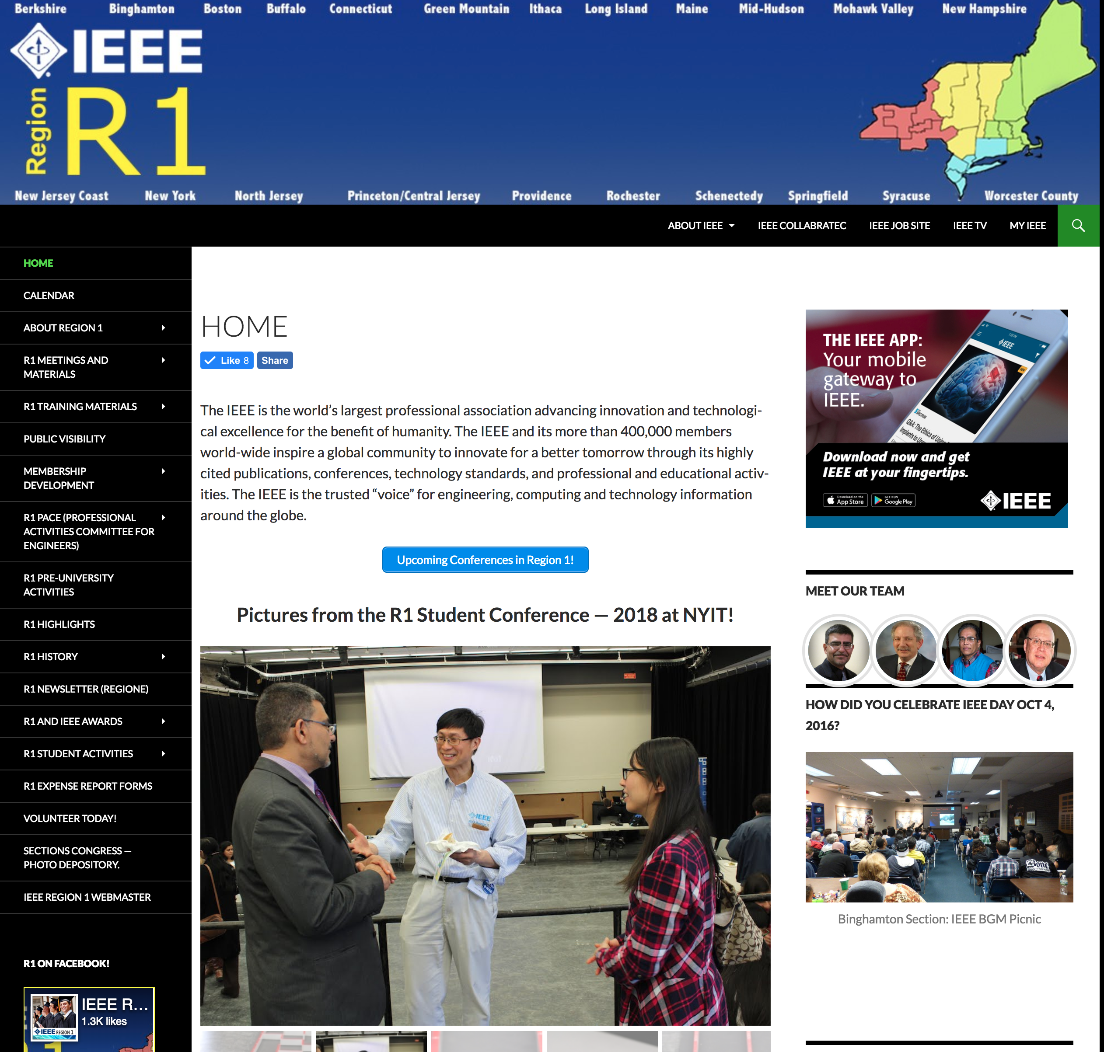
Webpage Contents
http://sites.ieee.org/r1/
Overall layout of the webpage is stable
Added promotions for IEEE App
Maintained long term storage of data for Excom and BoG meetings
Modified all officers across the region. This includes photos and contact information
Added training documents of training sessions
Enhanced registration for BoG meeting. Will be used in the future for student meetings.
Information Management Report (Greg.gdowski@gmail.com)

Slide 3
Maintain and manage all R1 IEEE listserves.
R1-SECTION-CHAIRS@IEEE.ORG
R1-NORTH@IEEE.ORG
R1-CENTRAL@IEEE.ORG
R1-WESTERN-AREA@IEEE.ORG
R1-SOUTH@IEEE.ORG
Information Management Report (Greg.gdowski@gmail.com)

Slide 4
Other activities
Managed the registration and advertising for the student meeting.
Managed the registration process for the BoG meeting.
Relayed and provided communication support for the region as needed.
Provided support for advertising many events, including the R1 Student Conference.

Slide 5
Upcoming changes
Need to get approval for all pictures posted on the web.
The web site will be migrated to a new server.
With that will come a revision to the web pages with a new template.
It is also possible that the student web site will be migrated and integrated into the R1 webpages.

Slide 6
Questions? Thank you!
Information Management Report (Greg.gdowski@gmail.com)

