Slide 1
Greg Gdowski, PhD
Nominee
Region 1 2020-2021 Director Elect/Delegate Elect

Slide 2
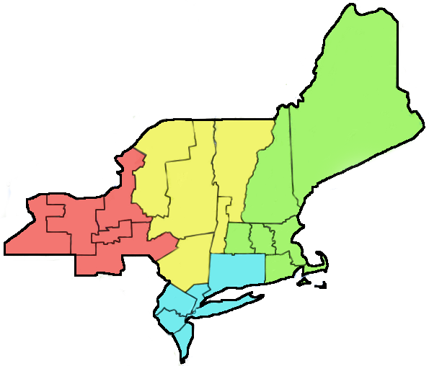
Life experience from within R1
Raised in Rhode Island
Family business in Southeastern Massachusetts
Attended Boston University
Have worked in both academics and industry
Welch Allyn/Blue Highway in Syracuse, NY
Associate Professor, Biomedical Engineering University of Rochester
Executive Director
Center for Medical Technology & Innovation

Slide 3
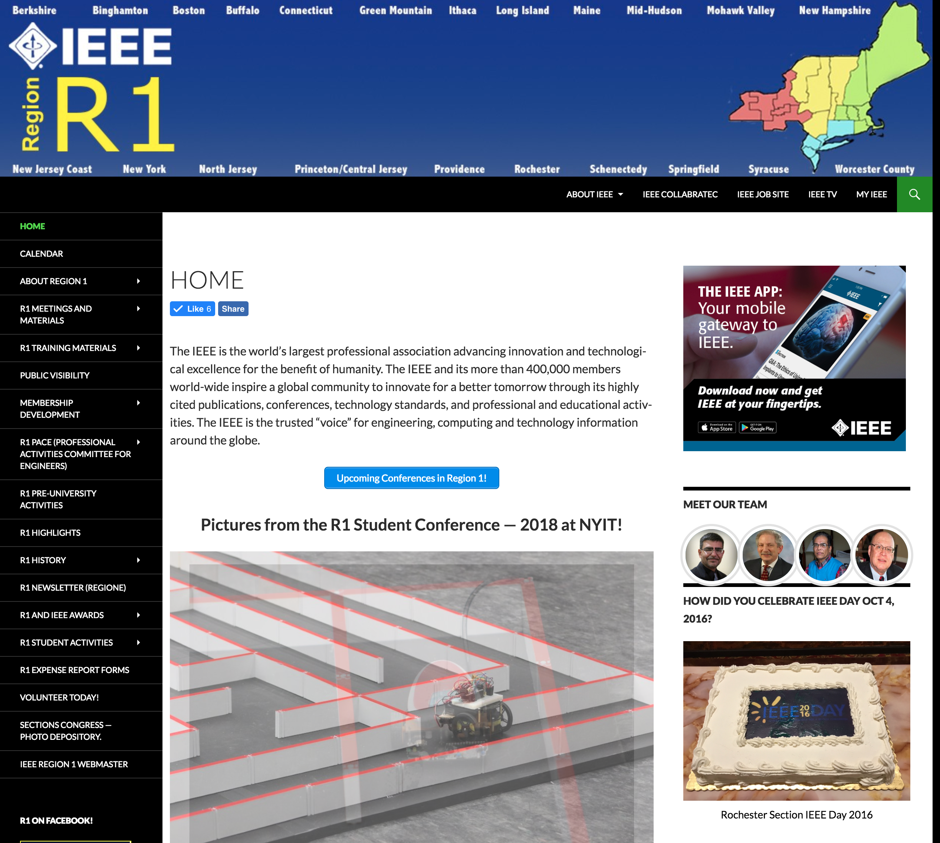
Long history of volunteering for IEEE within R1!
2008-10 Chair: Rochester EMBS
2009-10, 2013-14 Vice Chair, Rochester
Section Chair in two R1 Sections
2011-2012 Section Chair, Syracuse
2014-2018 Section Chair, Rochester
2015-present R1 Information Management Coordinator & Webmaster
2018-present R1 Western Area Chair
http://sites.ieee.org/r1/

Slide 4
Why am I interested in running for election as the R1 Director-Elect?
Goal 1: Improve the sense of community across R1
Goal 2: Prioritize membership recruitment and retention throughout R1
Goal 3: Increase the promotion of women engineers and scientists within R1

Slide 5
Goal 1: Improve the sense of community across R1
Problem: Greatest challenge is the size of the region. There is a tendency to function more like 22 individual sections.
Solutions:
One in-person BoG meeting, two additional web-based goal-directed meetings focused on Sectional and Regional activities.
More extensive communications from the Region to Sections and our membership.

Slide 6
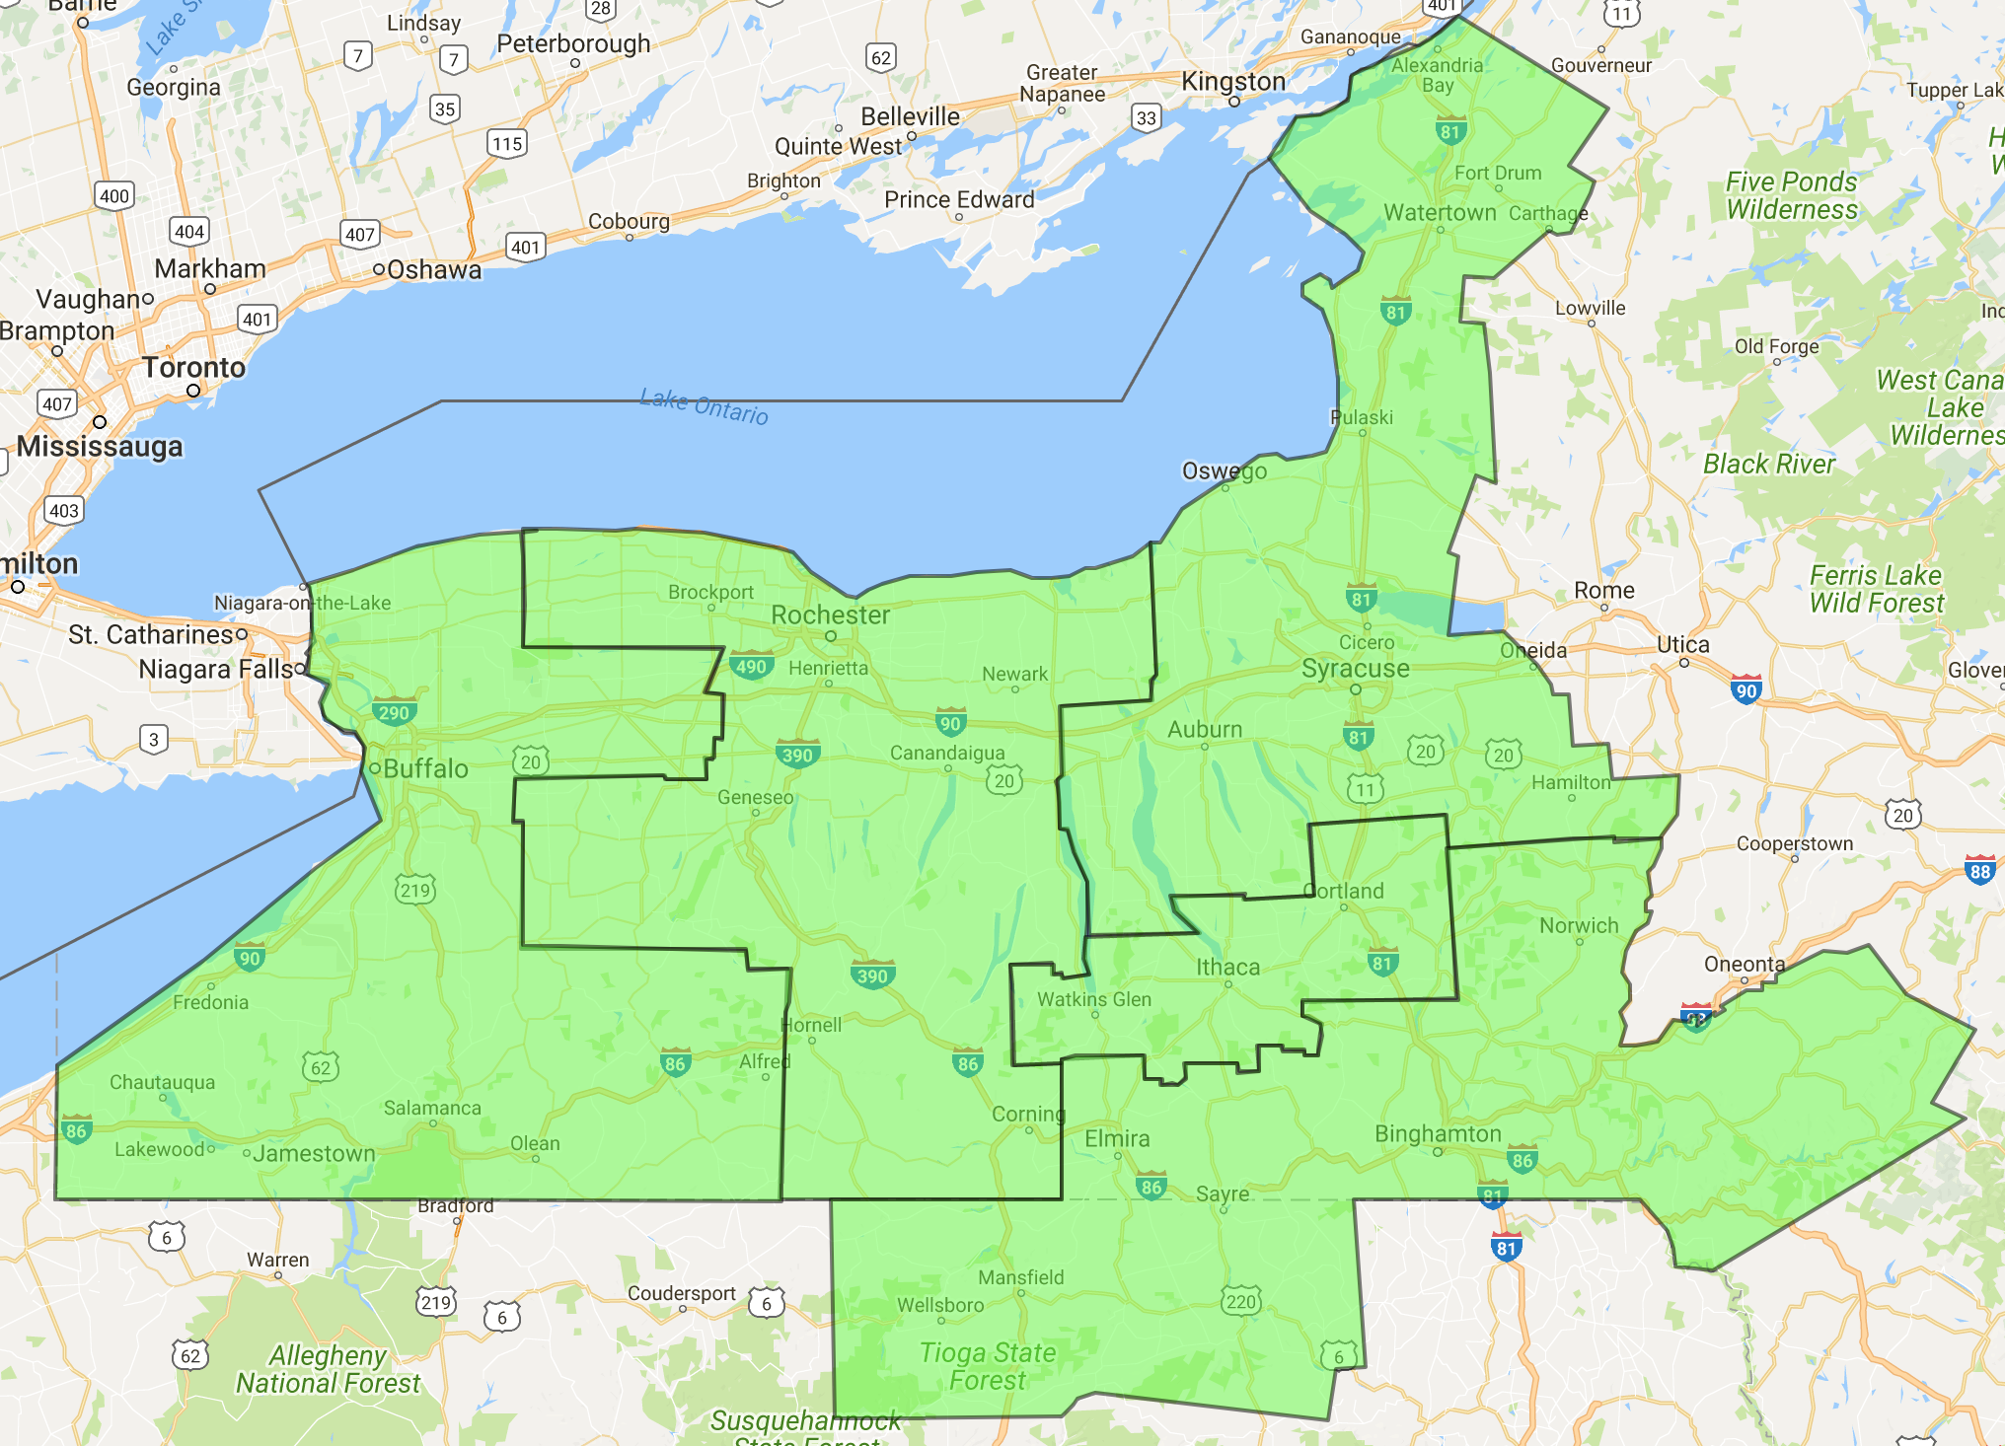
Goal 2: Prioritize membership recruitment and retention throughout R1
Enhance the value of membership throughout R1
For regular members:
Facilitate greater collaboration in promoting events and sharing speakers
Broadly promote R1-funded events
R1 Western Area
?
?
?
?

Slide 7
Goal 2: Prioritize membership recruitment and retention throughout R1
Enhance the value of membership throughout R1
For student members:
Expand the R1 Student Conference
Add career development workshops
Add a University graduate school fair
Add opportunities for graduate students

Slide 8
Goal 2: Prioritize membership recruitment and retention throughout R1
Enhance the value of membership throughout R1
For student members:
Expand the R1 Student Conference
Add career development workshops
Add a University graduate school fair
Add opportunities for graduate students
Regional recruitment targeted at large schools with low numbers of members
IEEE OU Analytics, July 2018
School Name | Undergraduates
Wentworth Inst of Tech | 86
City College Of New York | 71
New Jersey Inst Of Tech | 69
The College of New Jersey | 60
Boston Univ | 7
Yale Univ | 3
Cornell Univ | 2
Princeton Univ | 3
Brown Univ | 2

Slide 9
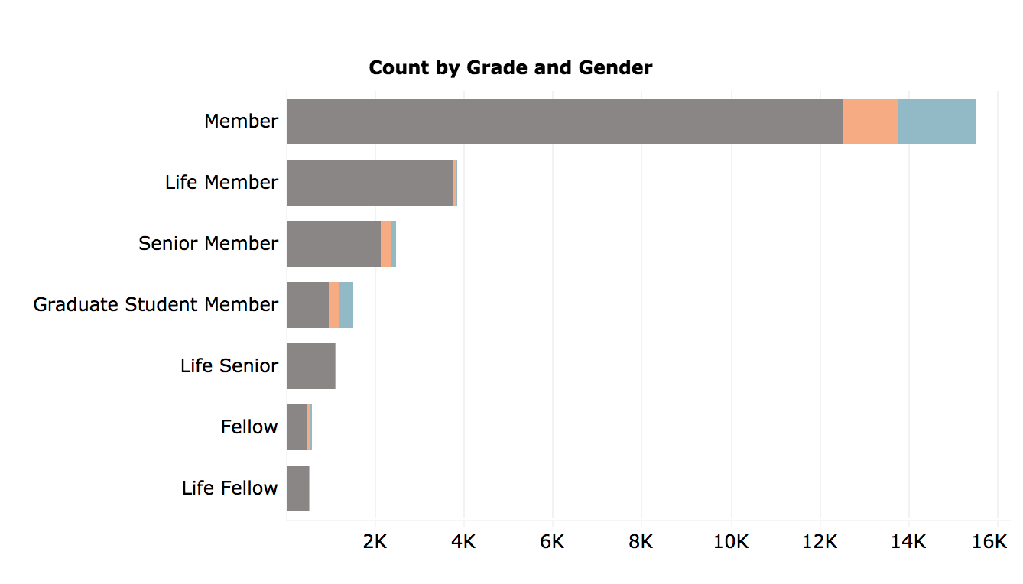
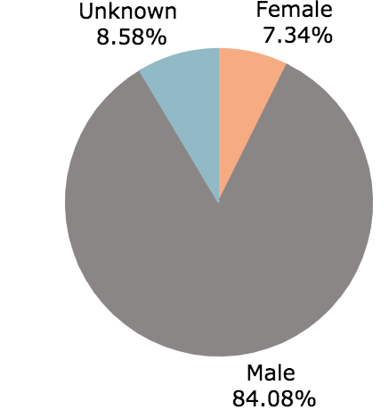
Goal 3: Increase the promotion of women engineers and scientists
Problem: Women represent only 7.3% of R1 members. Only 11% of R1 IEEE Fellows are women. There are only 7 women on the R1 BoG.
Solutions:
More active recruitment of women to R1 leadership
More active role in promoting R1 WIE across all Sections.
IEEE OU Analytics
R1 members 7/2018

Slide 10
Region Directors serve as Region Delegates representing the members of its constituents. They are a member of the IEEE Board of Directors, and are voting members on the MGA Board and Assembly, and the IEEE-USA Board.
Serving as your R1 Delegate
It is important to have an individual that understands the needs of Region 1.
I am an IEEE Senior Member that has been a member for 15yrs that has been active in leadership roles in R1 for the last 10yrs.
I have served as a volunteer for numerous engineering and professional organizations including:
MedTech Board (>100 Biotech companies) 5 years
Rochester Engineering Society; Board Member and 1st Vice President

Slide 11
Thank you for your attention!

